Slide 1
Working with the Taxpayer Advocate Service
Tax Professionals

Slide 2
Sheila Andrews sheila.l.Andrews@irs.gov
Cell: 317-260-7269

Slide 3
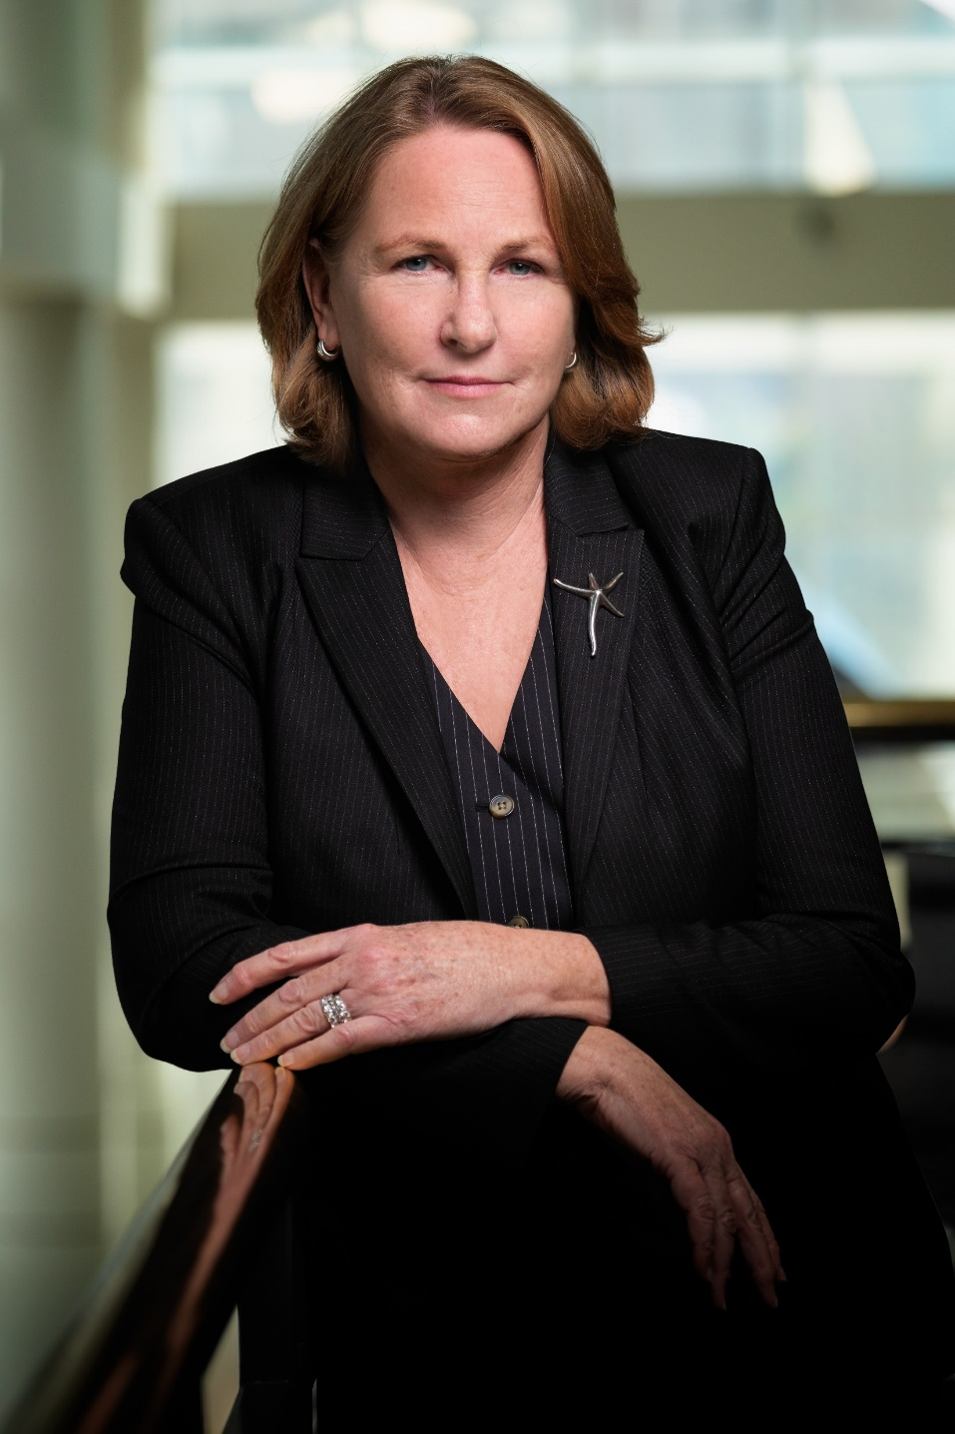
TAS Leadership
Erin M. Collins
National Taxpayer Advocate

Slide 4
Your Local Taxpayer Advocate
(LTA)
Indianapolis
  575 N. Pennsylvania St.
  Stop TA771
  Indianapolis, IN 46204
Phone: (317) 685-7840
Fax: (855) 827-2637
Email: tas.in.indianapolis@irs.gov
Holli Bryl – Acting, LTA
holli.m.bryl@irs.gov

Slide 5
ABOUT TAS – WHO WE ARE
Independent organization within the IRS
Provide free service to all eligible taxpayers, including:
  Individual taxpayers
  Businesses
  Non-profits
  More
No income limits for eligibility
Your Voice at the IRS

Slide 6
ABOUT TAS
Assist taxpayers to resolve tax problems with the IRS.
Identify areas where taxpayers have problems dealing with the IRS.
To the extent possible, propose changes in the administrative practices of the IRS to mitigate problems.
Identify potential legislative changes to mitigate such problems.
TAS Functions by Law

Slide 7
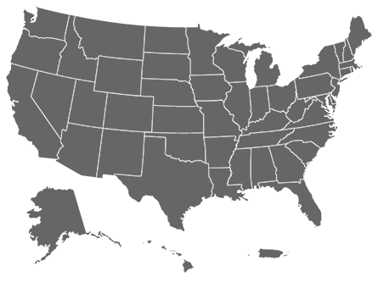
ABOUT TAS – Offices
Office of the Taxpayer Advocate
  Washington, D.C.
Local TAS offices nationwide
  One (or more) in every state
  One in Washington, D.C.
  One in Puerto Rico
Your Voice at the IRS

Slide 8
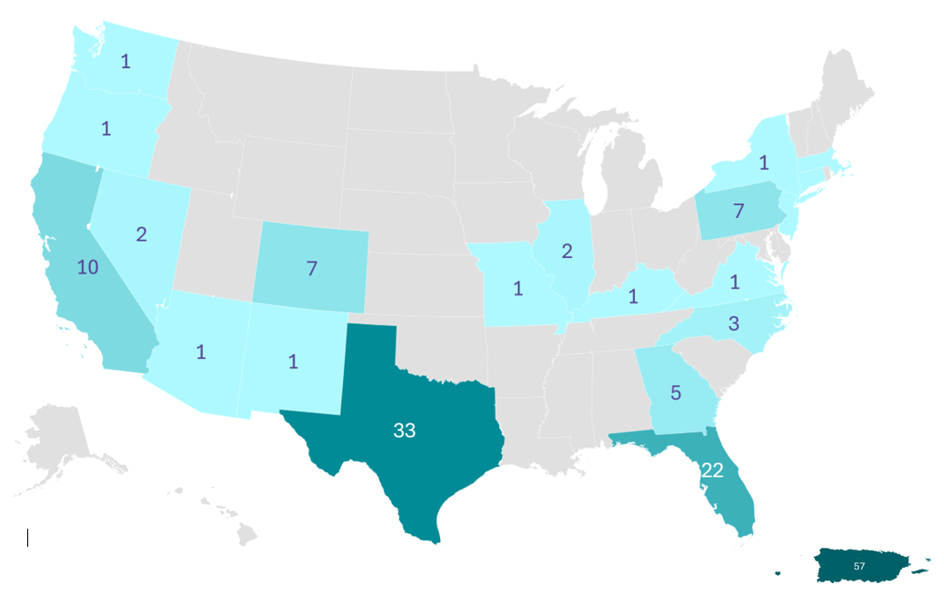
Spanish-speaking/Bilingual case advocacy employees
There are 160 bilingual Case Advocacy employees located in 21 states and Puerto Rico:
44 Intake Advocates
104 Case Advocates, Lead Case Advocates, and Case Advocate Supervisors
12 Secretaries, Technical Advisors, and Analysts

Slide 9
About TAS – What We Do
Protect your clients’ rights by striving to ensure they are treated fairly and understand their rights as outlined in the Taxpayer Bill of Rights.
Help taxpayers where a system failed to operate as intended or efforts failed to resolve the problem within the IRS.
If your client qualifies for help, TAS is with you at every turn and does everything possible to assist.
Your Voice at the IRS

Slide 10

TAXPAYER BILL OF RIGHTS
= YOUR RIGHTS

Slide 11

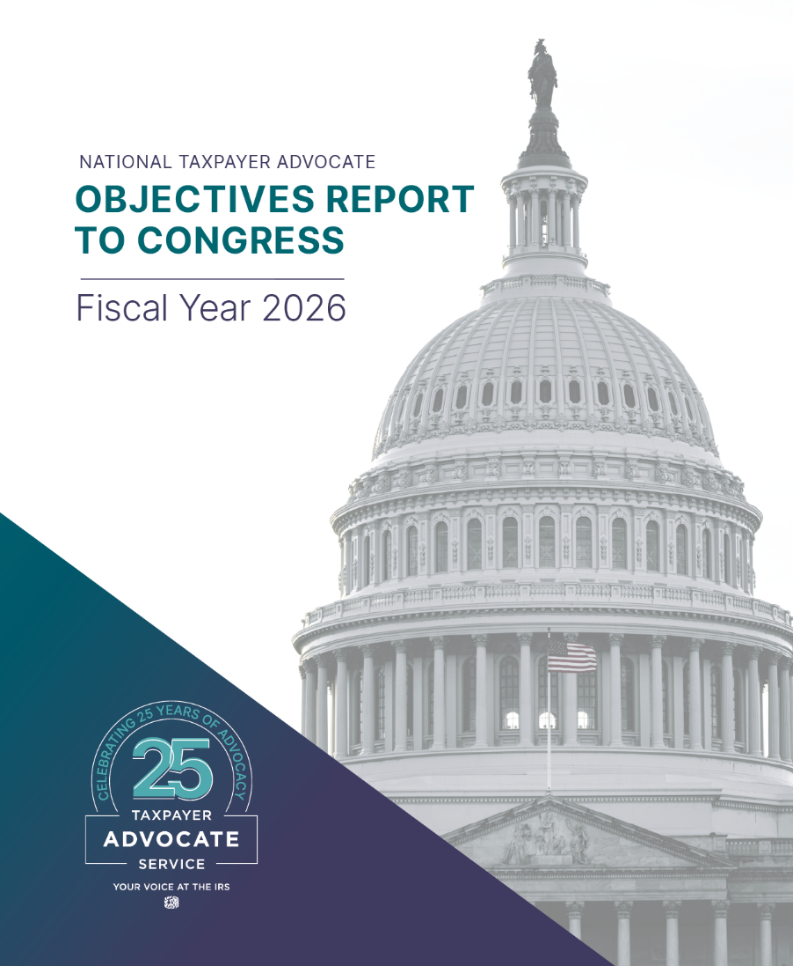
TAS REPORTS TO CONGRESS
https://www.TaxpayerAdvocate.irs.gov/reports

Slide 12
WHEN TO COME TO TAS FOR TAX ACCOUNT HELP
Your client is experiencing a financial/economic hardship or facing an immediate threat of adverse action.
You are unable to resolve your client’s issue through normal IRS channels.
You have tried to contact the IRS, but no one has responded, or the IRS hasn’t responded by the date promised.
Learn more about eligibility at: https://www.taxpayeradvocate.irs.gov/can-tas-help-me-with-my-tax-issue/
In general, come to us when:

Slide 13

How to contact tas
The number for your Local Taxpayer Advocate office is in your local directory and at: www.taxpayeradvocate.irs.gov/contact-us
Fax or phone the Local Taxpayer Advocate office listed in Publication 1546, Your Voice at the IRS
Call the NTA Case Intake Line: 1-877-777-4778
Download Form 911, Request for Taxpayer Advocate Service Assistance, from irs.gov

Slide 14
What to Expect
TAS will advocate with you on your client’s behalf = Your Voice at the IRS.
Contact within ten business days (or less) from the date you contacted us or the date your inquiry was referred to us.
In most instances, TAS must rely on the IRS to take the action needed to resolve the issue.​
Our role is to ensure actions are completed accurately and expeditiously and the taxpayer’s rights have been protected.​
Case Advocates are responsible for keeping you informed of their progress throughout the case.
You will also be provided with a clear, complete, and correct explanation of what was done to resolve the problem when we are done.

Slide 15
What to Expect
Your prompt reply to requests for additional information will ensure we can continue to advocate for you and your client.
If we are continuously unable to reach you by phone or by letter, our office may be required to contact the taxpayer directly or possibly close the case.
Additional information is generally needed to resolve inquiries. Documentation may include:
  Power of Attorney or other authorization.
  Copies of any IRS notices or letters your client has received.
  Completed and signed forms including returns, schedules, and the information to support the returns/schedules.
Notes:
What to Expect
To allow us to advocate on your (your client’s) behalf, please respond promptly with any information requested. You and the case advocate will agree on a reasonable timeframe for submitting whatever documents are required.
If we do not hear from you, we will make a second request for information in writing, including a new response due date.
If we are continuously unable to reach you by phone or by letter, our office may be required to contact the taxpayer directly or possibly close the case.
We may close your inquiry without further contact if you do not respond to the second request.
If this happens and the case is closed, it means you will then have to contact the IRS directly to resolve your problem.
We may need you to submit a completed/signed Power of Attorney form, if it is not already processed by the IRS and showing as filed.
Form 2848 vs. Form 8821
Form 2848, Power of Attorney and Declaration of Representative, must only be used by an individual eligible to practice before the Internal Revenue Service. For information on Powers of Attorney see IRS Publication 947, Practice Before the IRS and Power of Attorney. Form 2848 includes Attorneys, Certified Public Accountants, Enrolled Agents, Enrolled Actuaries, Unenrolled Return Preparers, Students /Law Graduates, and Enrolled Retirement Plan Agents.
Form 8821, Tax Information Authorization, or equivalent, can appoint any third-party to receive and inspect account information for the tax matter(s) specified. Form 8821 authorizes the appointee to receive limited confidential information for the tax matters and tax periods specified on the form. It does not authorize the appointee to negotiate with the IRS on behalf of the taxpayer, advocate the taxpayer’s position to IRS officials or employees.
Please send us copies of any IRS notices or letters your client has received.
If a particular form is needed to assist us with requesting an official action (such as a special claim form for innocent spouse, a financial information statement for your client, an Offer in Compromise form that may have been filed previously, etc.), you will need to submit this, along with any supporting documentation, as required, to process the request.
Be sure any form, including tax returns, are completed, signed, and dated by the taxpayer.
Note: TAS offices are not a designated place for filing returns, and TAS employees have not been delegated the authority to accept hand-carried returns. So do not send tax returns to TAS for filing.

Slide 16
Phone Numbers and Voicemail
It is important that we have a good phone number on the account or on your Power of Attorney (Form 2848).
TAS cannot leave tax information on a representative’s answering machine or voicemail, even if the representative asks them to do so.
Identity verification is required – for everyone.
Notes:
Phone numbers and voicemail policy
It is important that we have a good phone number on the account or on your Power of Attorney (Form 2848).
If there are multiple POAs on the Form 2848 be sure to specify who we should contact primarily—that is, who is the person who will have the records and be most knowledgeable about the issue.
Please note, the Case Advocate cannot leave tax information on a representative’s answering machine or voicemail, even if the representative asks them to do so.
Know that when a taxpayer has a valid Form 2848 on file and the taxpayer contacts TAS for assistance, the Case Advocate must inform the taxpayer of the requirement for us to contact you - the POA.
The Case Advocate is responsible for protecting tax returns and tax return information and Privacy Act records. Therefore, he/she is responsible for verifying (authenticating) that they are speaking to the correct taxpayer/representative.
As part of an ongoing effort to combat identity theft, the IRS is requesting some personal information, in addition to the CAF number, from tax professionals. The purpose is to confirm the identification of the person calling prior to releasing sensitive information. The intent is to enhance protections for tax professionals and their clients.
We are now required to ask for your personal SSN as part of the authentication process.

Slide 17
Systemic Advocacy
Systemic Advocacy studies and seeks to resolve problems, both reactively and proactively, that affect groups of taxpayers, including problems that affect individuals, businesses, or both.
Systemic issues:
Affect multiple taxpayers;
Are not individual problems or cases;
Require analysis, administrative solutions, or legislative changes; and
Involve protecting taxpayer rights, reducing or preventing taxpayer burden, striving to ensure equitable treatment of taxpayers, or providing essential services to taxpayers.
https://www.irs.gov/sams
Notes:
In addition to advocating to resolve individual issues, TAS works to resolve systemic issues.
The Office of Systemic Advocacy has responsibility for the TAS programs that address systemic problems within the IRS.
By definition, Systemic Advocacy means identifying and addressing systemic tax problems by analyzing their root causes and recommending corrective action.
Systemic Advocacy advocates for systemic and procedural change, both reactively and proactively.
Systemic Advocacy focuses on issues that impact multiple taxpayers, or a defined group of taxpayers, rather than problems that occur on a single federal tax return.
Issues can be submitted at the link shown on this slide. Please do not include any identifying information in your submissions.

Slide 18
The IRS Practitioner Priority Service
The Practitioner Priority Service (PPS) is your first point of contact with the IRS for account-related issues.
PPS is staffed by specially trained IRS customer service representatives.
PPS is available to all tax professionals with valid third-party authorizations, i.e., Forms 2848, 8821, and 8655.
Contact PPS at 866-860-4259
  Continental U.S., 7 a.m. to 7 p.m. local time
  Alaska and Hawaii, 7 a.m. to 7 p.m. Pacific time
  Puerto Rico, 8 a.m. to 8 p.m. local time
For more information about PPS, visit the IRS website: Practitioner Priority Service ® | Internal Revenue Service (irs.gov)
Notes:
Another service the IRS provides is the Practitioner Priority Service, which is a dedicated telephone line exclusively for tax professionals.
Read slide.

Slide 19
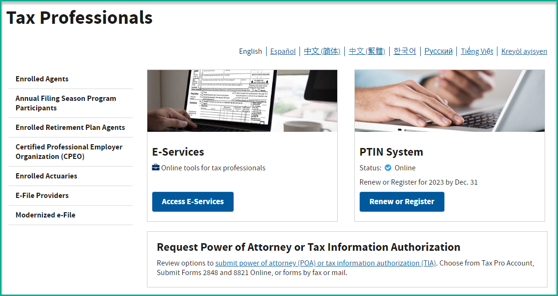
IRS Resources for Tax Professionals
Tax Professionals | Internal Revenue Service (irs.gov)
The IRS provides tax professionals access to various online tools and services.
Notes:
NOTE TO PRESENTER: This slide is for awareness of the information available on this IRS website.
Not all issues require TAS involvement. The IRS provides tax professionals access to various online tools and services at www.irs.gov/tax-professionals. From this site, you can review featured topics and tax news, access E-Services, renew your preparer tax identification number (PTIN), review options to submit a power of attorney or tax information authorization, link to continuing education, and much more.
Refer to irs.gov/tax-professionals for more information.

Slide 20

Other TAS Programs
Low Income Taxpayer Clinics
Low Income Taxpayer Clinics (LITCs) represent low-income individuals who have a tax dispute with the IRS, and provide education and outreach to individuals who speak English as a second language
LITCs provide services for free or no more than a nominal fee (except for reimbursement of actual costs incurred)
Find the nearest LITC at: https://www.taxpayeradvocate.irs.gov/about-us/low-income-taxpayer-clinics-litc/#LITC-finder
Notes:
Before we conclude our presentation today, let me just mention two other TAS Programs.
Low Income Taxpayer Clinics (LITCs) are independent from the Internal Revenue Service (IRS) and TAS. LITCs represent individuals whose income is below a certain level and who need to resolve tax problems with the IRS. LITCs can represent taxpayers in audits, appeals, and tax collection disputes before the IRS and in court.
In addition, LITCs can provide information about taxpayer rights and responsibilities in different languages for individuals who speak English as a second language. Services are offered for free or a small fee.
For more information or to find an LITC near you, see the LITC page at www.irs.gov/advocate/low-income-taxpayer-clinics/low-income-taxpayer-clinic-map or IRS Publication 4134, Low Income Taxpayer Clinic List. This Publication is also available online at www.irs.gov or by calling the IRS at 1-800-829-3676.

Slide 21

Other TAS Programs
Taxpayer Advocacy Panel (TAP)
Independent panel of citizen volunteers
Suggests ways to improve the IRS
Contact TAP at 1-888-912-1227 or https://improveirs.org/
Notes:
The other TAS program I want to mention is the Taxpayer Advocacy Panel or TAP.
Taxpayers have an opportunity to provide direct input to the IRS through the Taxpayer Advocacy Panel (TAP). The TAP is an independent panel of citizen volunteers who listen to taxpayers, identify taxpayers’ issues, and make suggestions for improving IRS service and customer satisfaction. Contact TAP at www.improveirs.org.
So, Speak UP! and contact TAP to share your comments and suggestions on improving the IRS.
Also, annually, around March/April, TAP looks for new members. So if you are interested, keep your eyes open for those recruitment messages on:
TAP website,
TAS’s website,
In the general media, and
TAS’s Social Media sites.
(We will list our Social Media sites later.)
TAP members serve a three-year term. To be a member of the TAP, a person must be a U.S. citizen, be current with his or her federal tax obligations, be able to commit 200 to 300 volunteer hours during the year and pass a Federal Bureau of Investigation criminal background check.
For more information about what TAP does, about being a member or to submit a suggestion, call the number on the screen or visit the TAP website.

Slide 22




Want to Know More?
The Taxpayer
Advocate Service
is
YOUR VOICE
AT THE IRS
For more information, visit:
taxpayeradvocate.irs.gov/
es.taxpayeradvocate.irs.gov/ (Spanish)
taxpayeradvocate.irs.gov/get-help/roadmap/
taxpayeradvocate.irs.gov/tax-professionals/
Subscribe to our monthly newsletter:
taxpayeradvocate.irs.gov/contact-us/subscribe-to-tas/
GET CONNECTED
Notes:
We’ve covered a lot of information. If you remember nothing else from today’s presentation, remember this: The Taxpayer Advocate Service is Your Voice At The IRS, and for more information, visit https://es.taxpayeradvocate.irs.gov/. The TAS website is also available in Spanish. Visit https://es.taxpayeradvocate.irs.gov/.
Help us spread the word:
Tell your friends, family, or anyone else who might need help with an IRS federal tax related issue to go to our website and see if they qualify for TAS assistance.
Thank you all for attending today!

