Slide 1
OFFER IN COMPROMISE (OIC)
“Settling your tax debt for pennies on the dollar”
Charles R. Barrington (retiree from the Dark Side)

Slide 2
Definition
An offer in compromise is an agreement between a taxpayer and the government that settles a tax liability for payment of less than the full amount owed.

Slide 3
OIC Background
Revised Statutes § 3469 (1874) – Sec. of Treasury authorized
31 USC § 3711 (1982) – Civil (non-tax) debt
26 USC § 7122 – Tax debt
IRS Regulations
1950s – 1980s – Not well publicized
1992 – IRS updated and encouraged broader use as a collection resolution option
RRA 98

Slide 4
OIC Background (cont)
Early 2000s – standardization & financial analysis reforms
2010s – present – Digitalization and prcedural refinement
2012 - “Fresh Start” Initiative

Slide 5
Basis for OIC Consideration
Doubt as to collectibility
Doubt as to liability
Effective Tax Administration

Slide 6
Statute of Limitations
Examination
Generally, 3 years
From due date of return, or
Date return filed, whichever is later
Extended to 6 years if
25% understated gross income
Omission of $5000 or more from foreign assets
Unlimited:
Fraudulent
Never filed
Willful attempts to evade

Slide 7
Statute of Limitations
Collection:
Generally, 10 years
From assessment date
Paused if
Bankruptcy filed
Submission of OIC
Submission of Collection Due Process appeal
Living outside US for 6+ months
Taxpayer assistance order
Military Deferment
Installment agreement request

Slide 8
IRC § 7122(a)
“The Secretary may compromise any civil or
criminal case arising under the internal revenue
laws prior to reference to the Department of
Justice for prosecution or defense; and the Attorney
General or his delegate may compromise any such case after reference to the Department of Justice for prosecution or defense.”

Slide 9
Eligibility Requirements
Must have filed all tax returns
Must be current on estimated tax payments
Cannot be in an open bankruptcy proceeding
IRS considers ability to pay analyzing income, expenses, equity in assets

Slide 10
Basis for Granting an OIC
Doubt as to collectibility (DATC)
Doubt as to liability (DATL)
Effective tax administration (ETA)
Treas. Reg. § 301.7122-1(b)

Slide 11
Analyzing the acceptability of the OIC
Reasonable Collection Potential (RCP)
Net realizable value of assets
Future income
Offer must equal or exceed RCP

Slide 12
Payment Options
Lump Sum
20% initial payment; balance in 5 or fewer payments
Periodic Payment
Continuous monthly payments while IRS reviews the offer

Slide 13
Application Requirements
Form 656
Form 433A (OIC) or Form 433B (OIC)
$205 application fee

Slide 14
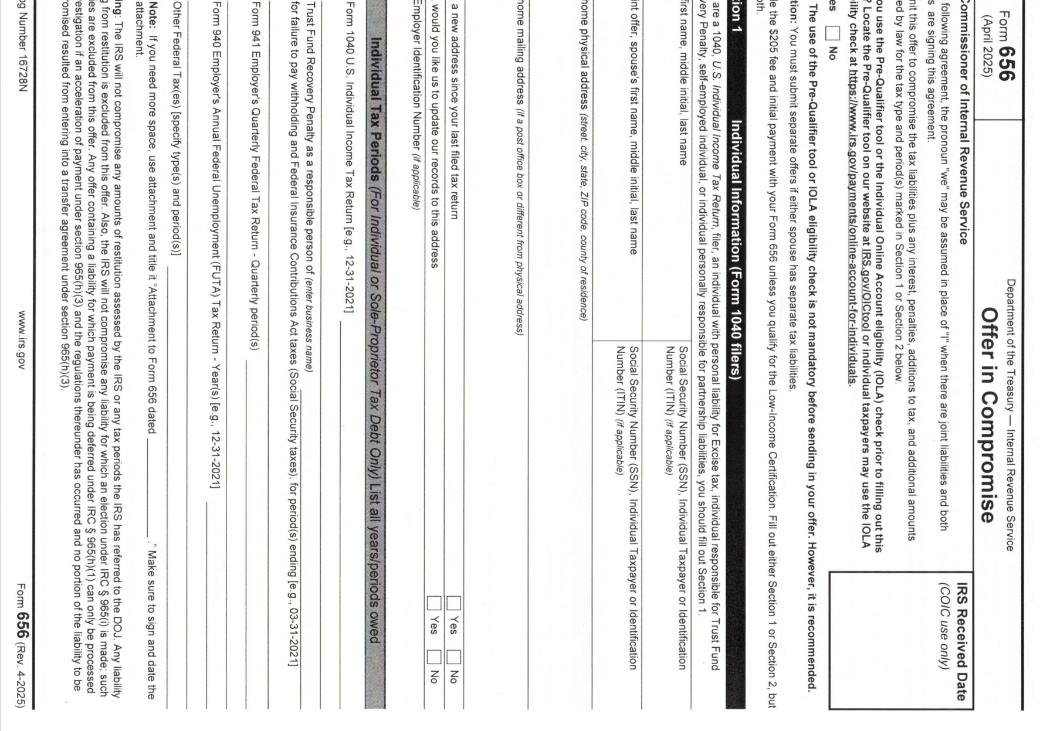
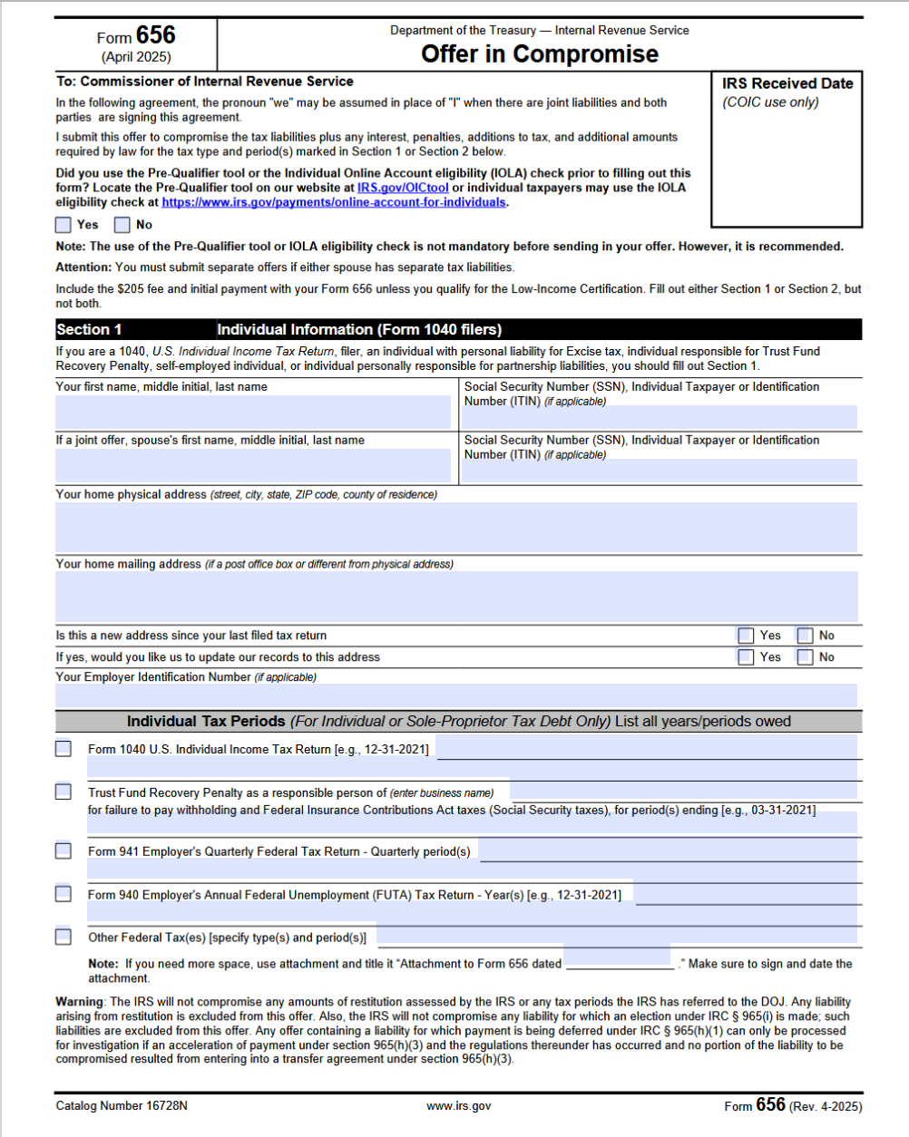

Slide 15
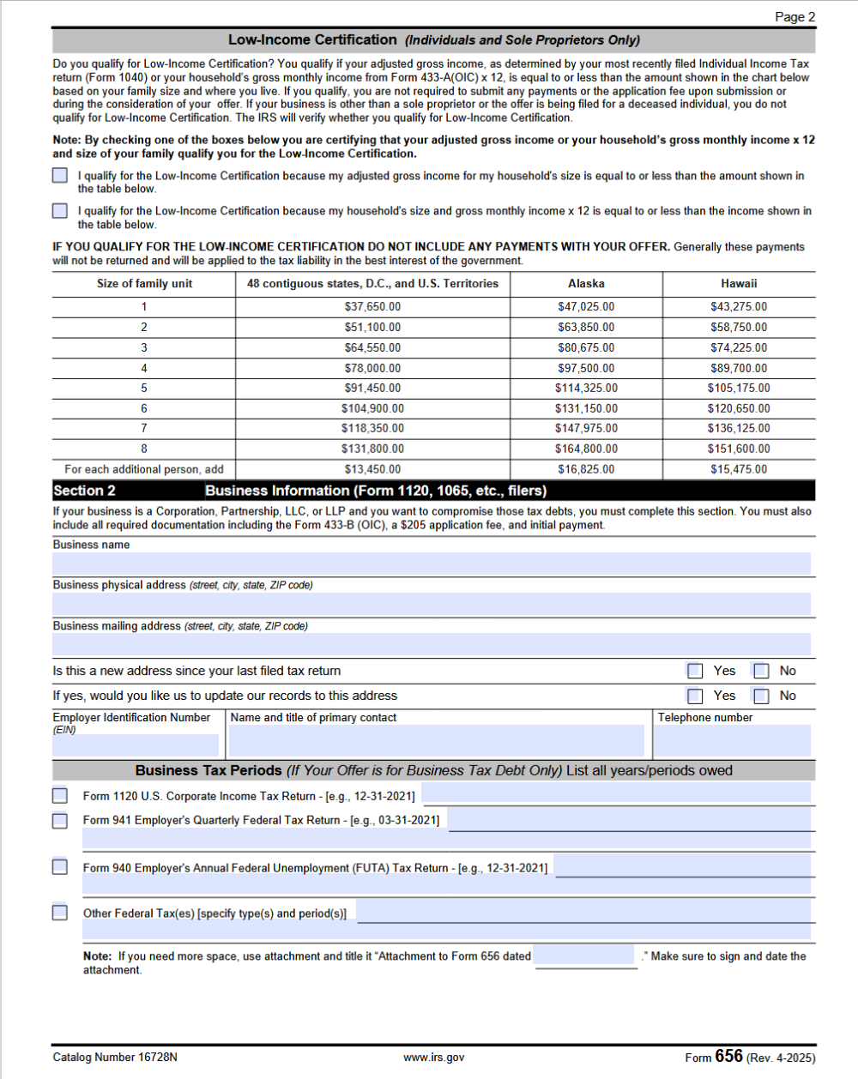

Slide 16
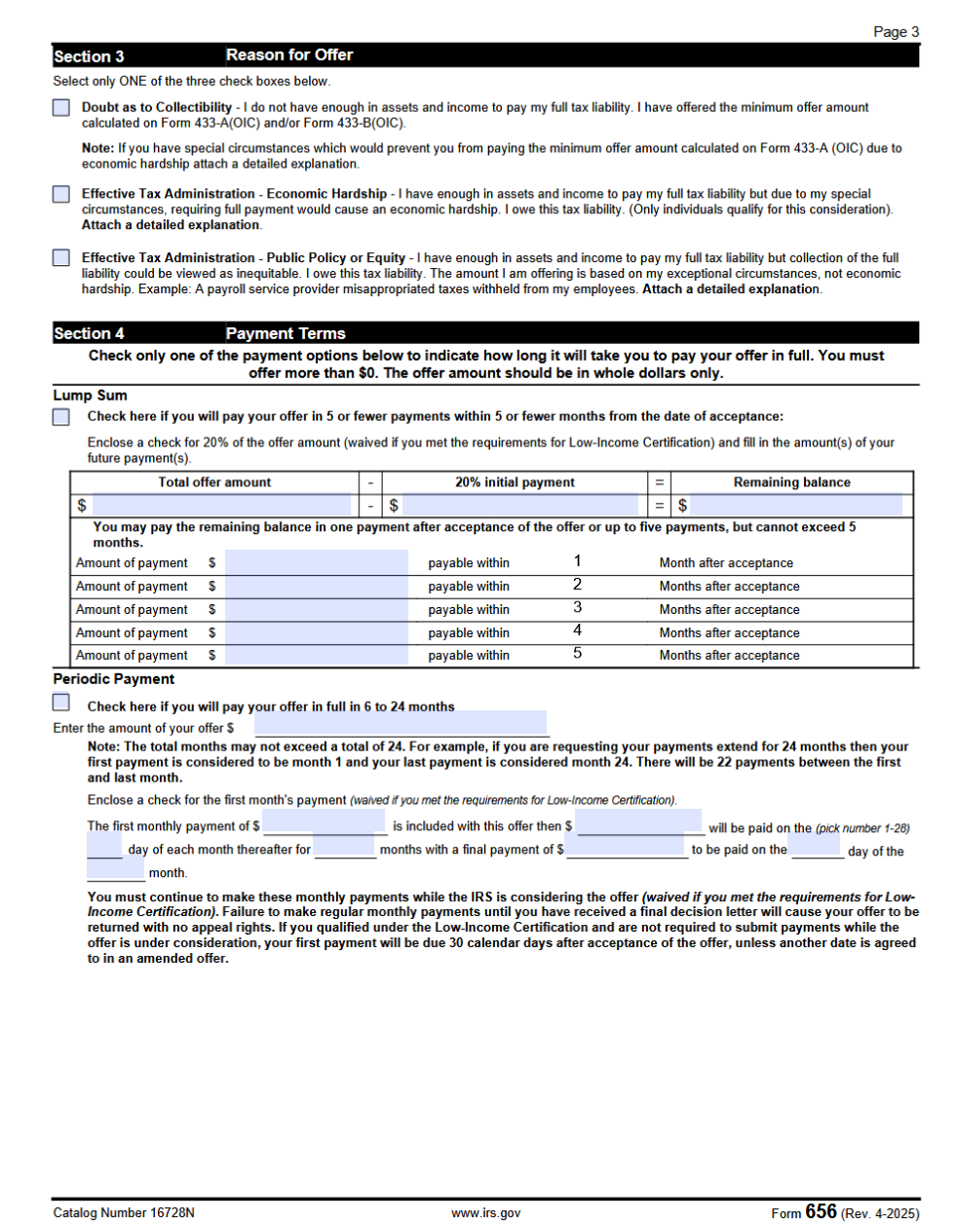

Slide 17
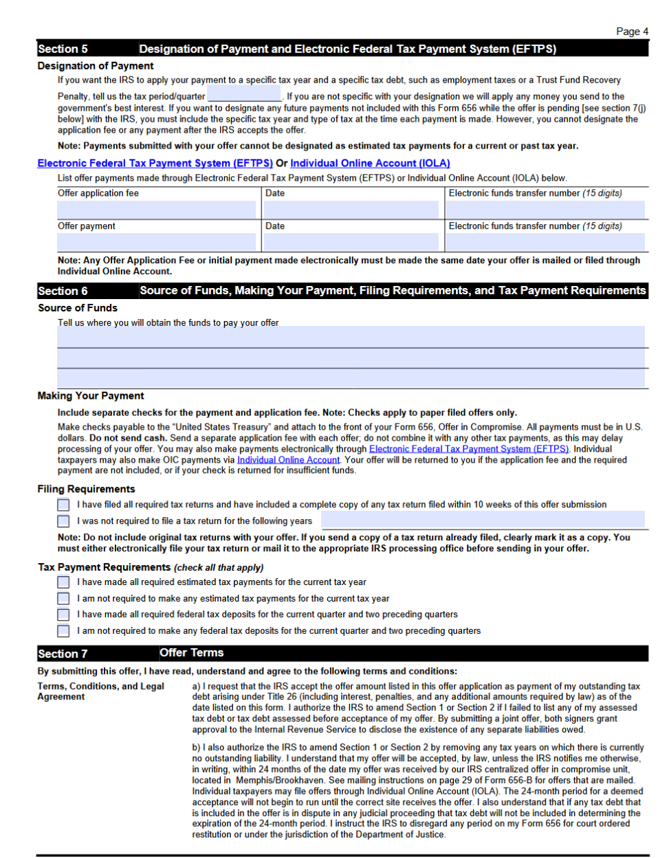

Slide 18
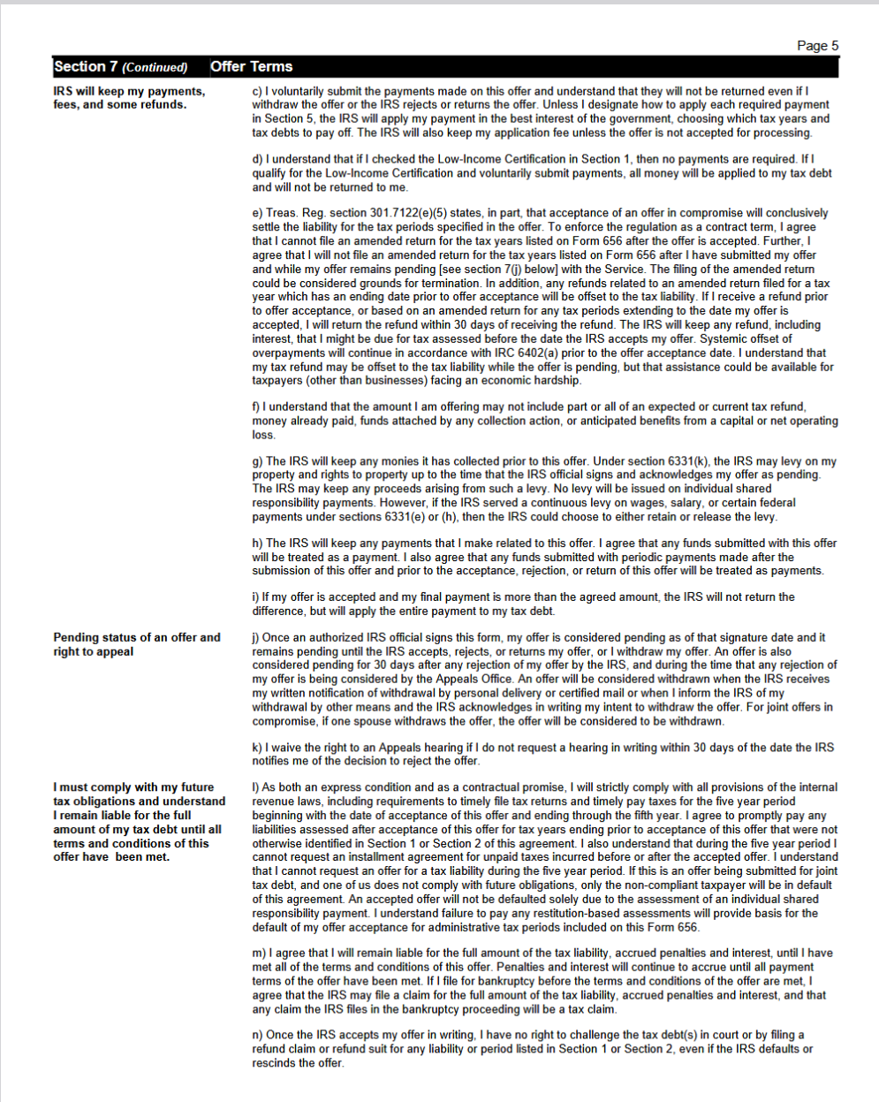

Slide 19
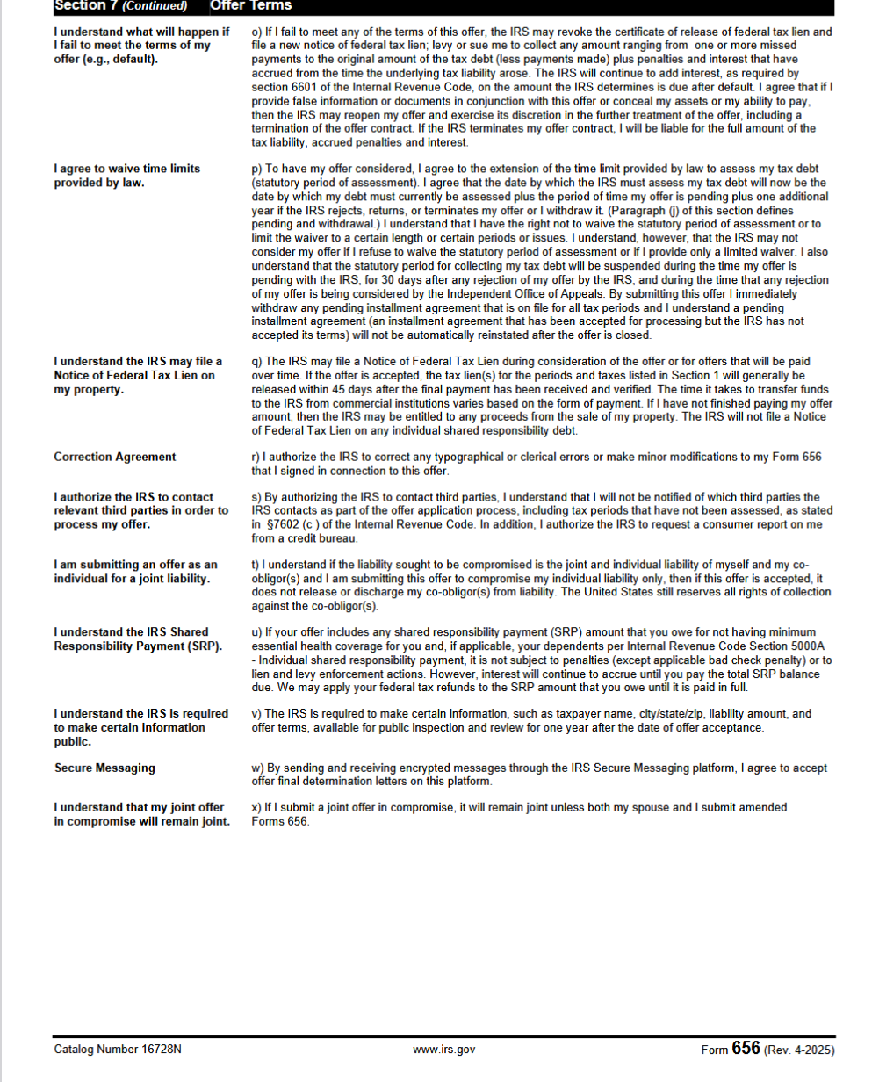

Slide 20
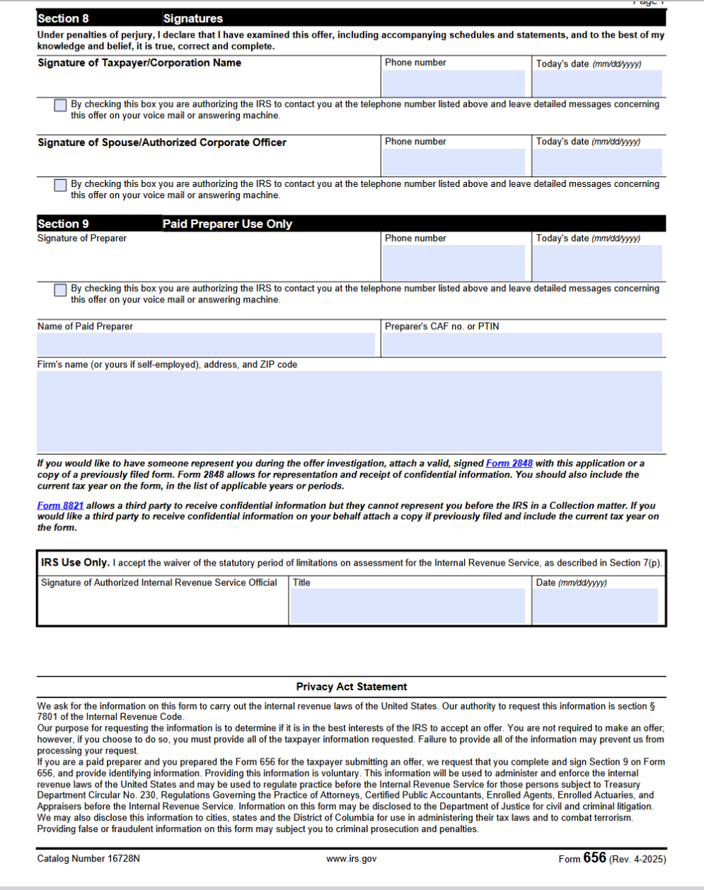

Slide 21
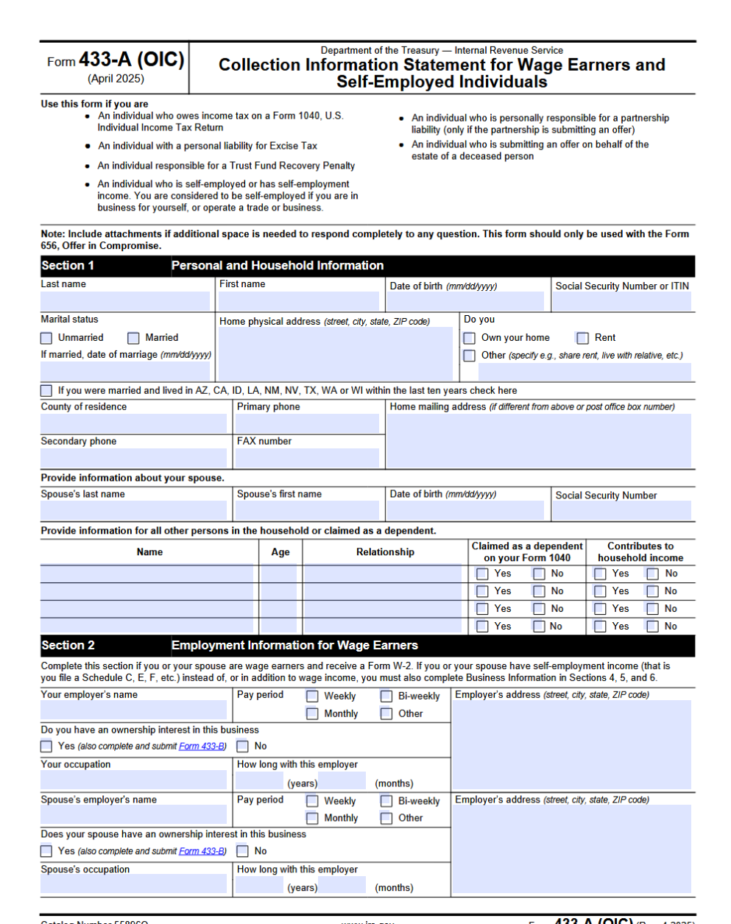

Slide 22
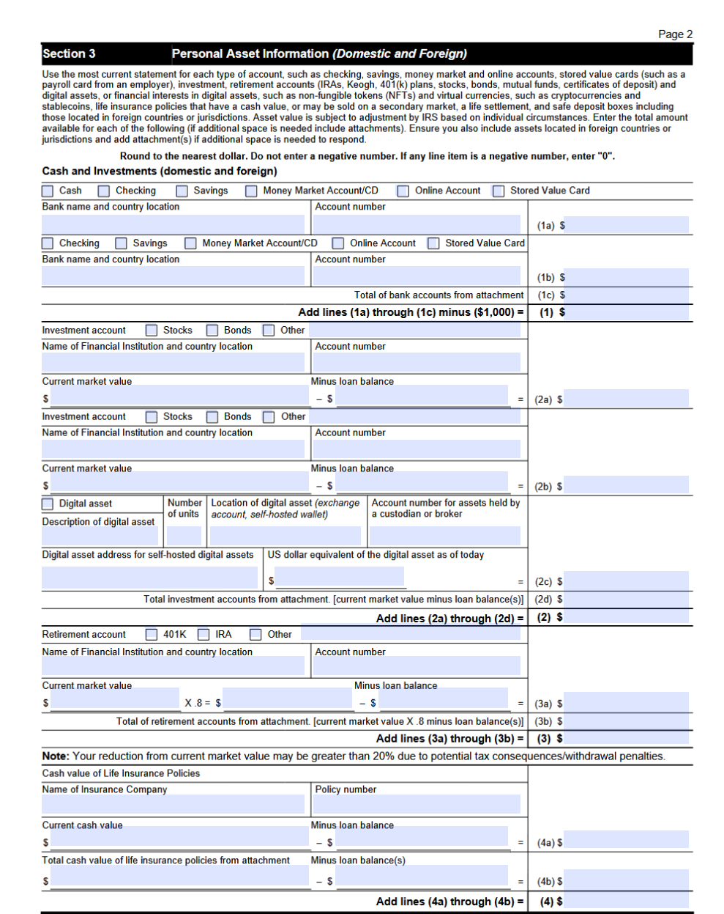

Slide 23
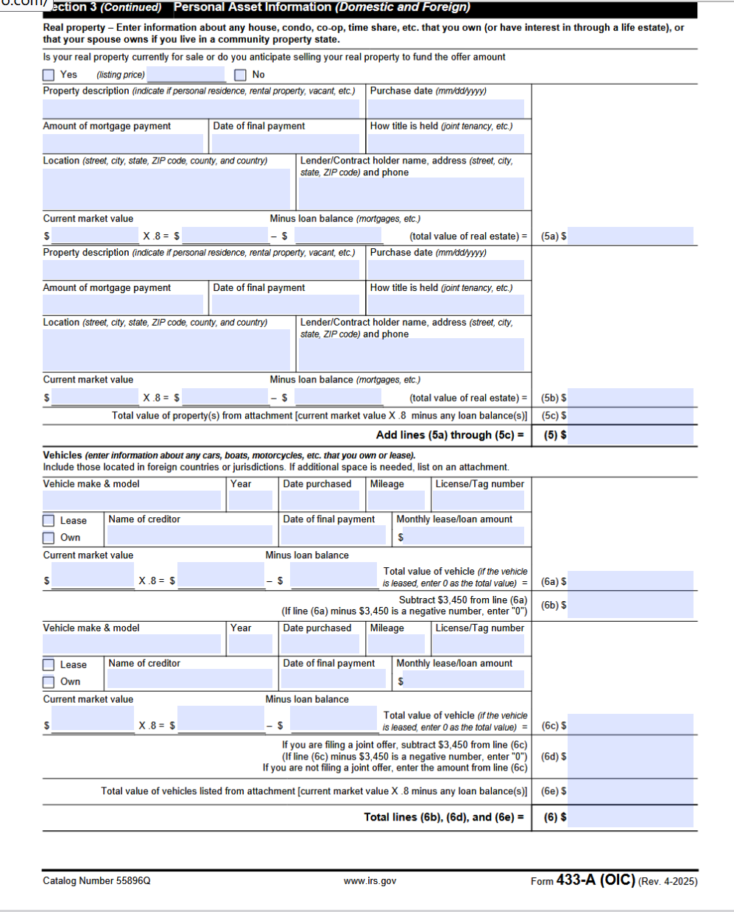

Slide 24
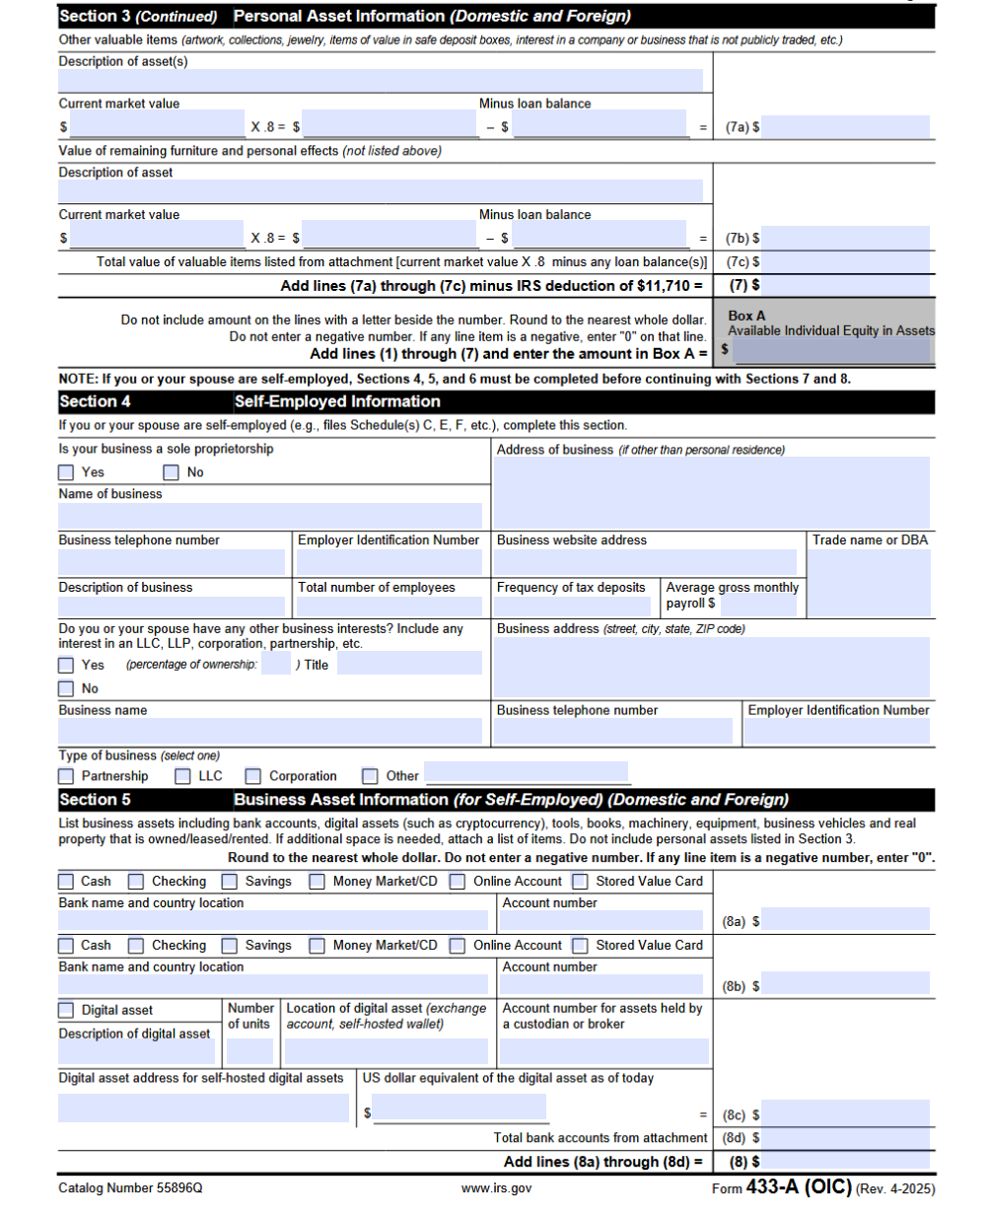

Slide 25
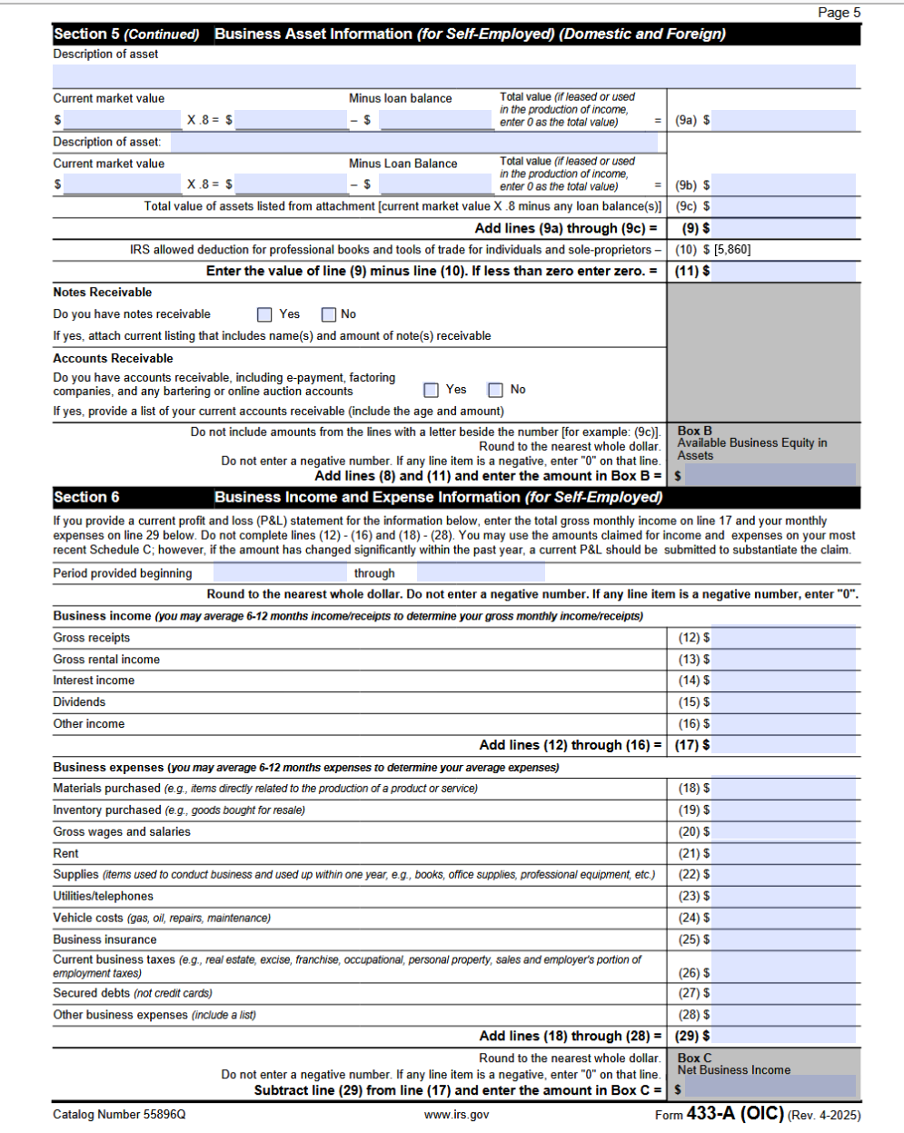

Slide 26
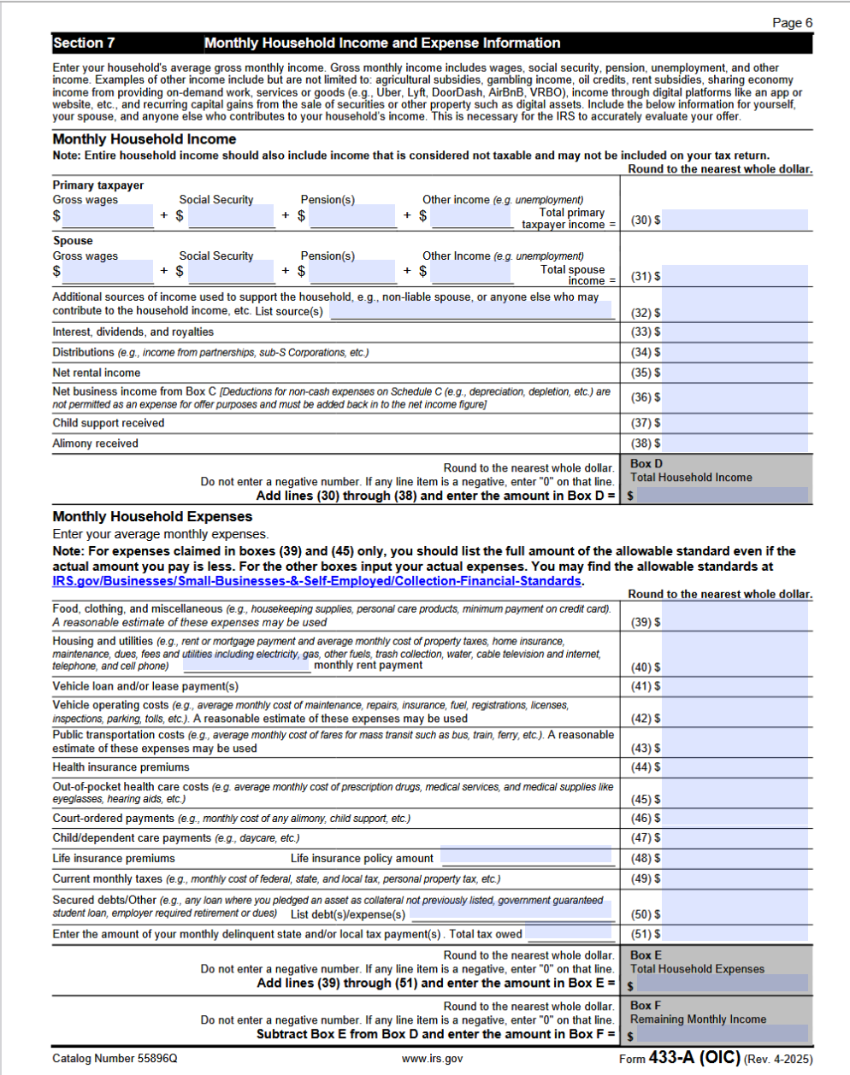

Slide 27
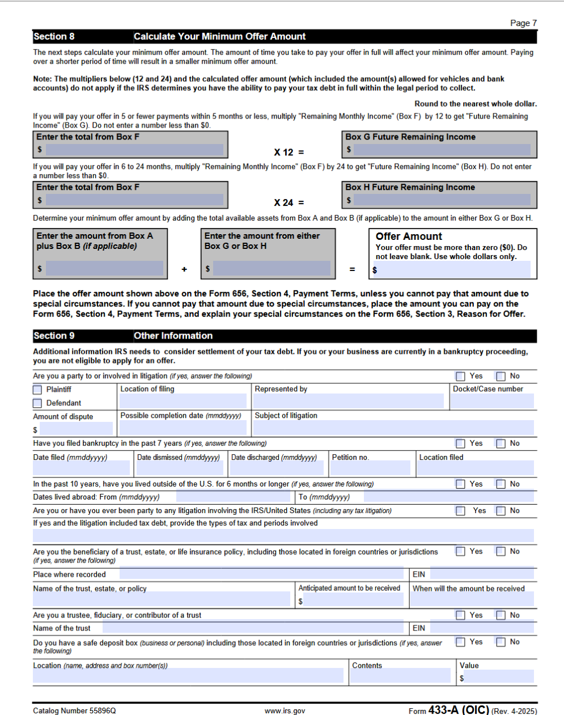

Slide 28
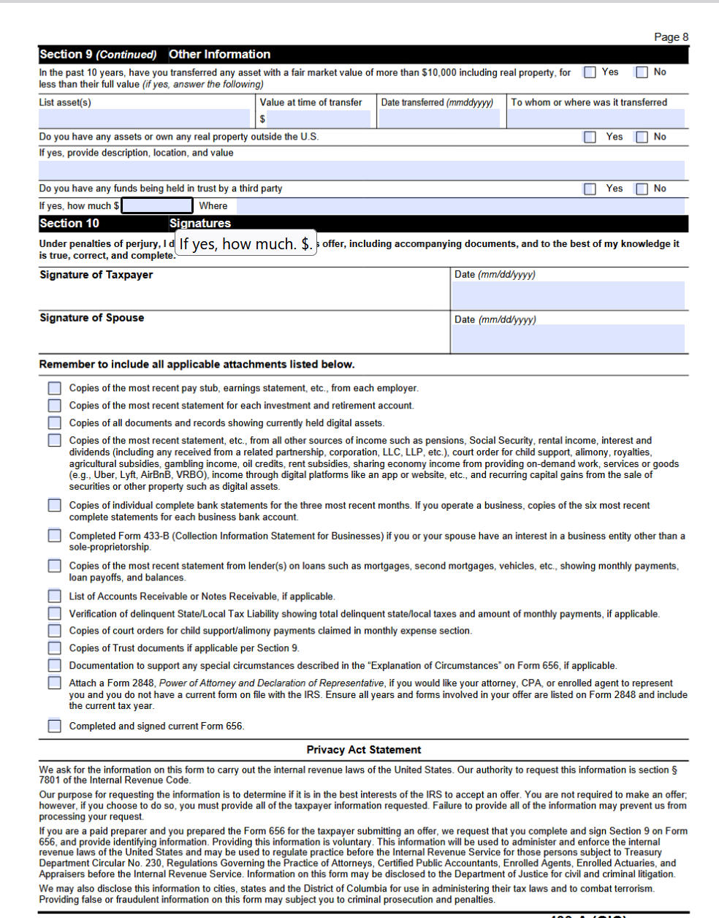

Slide 29
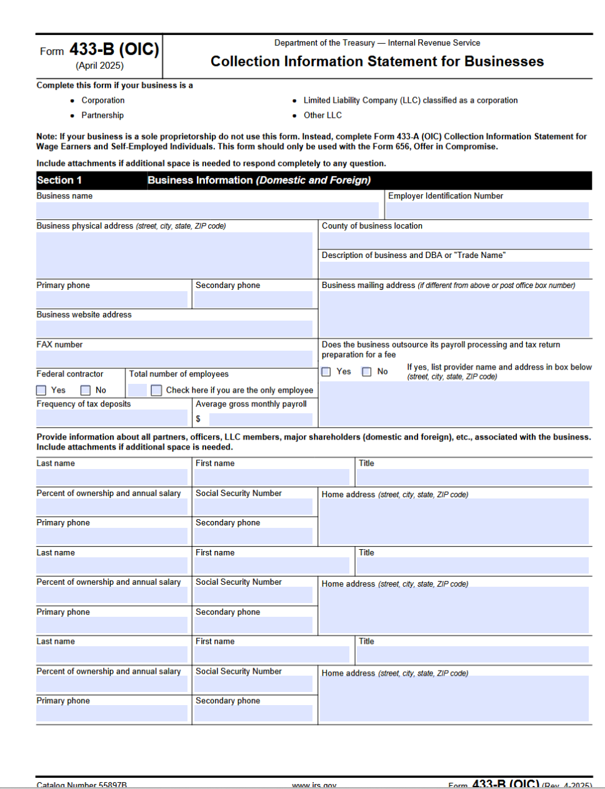

Slide 30
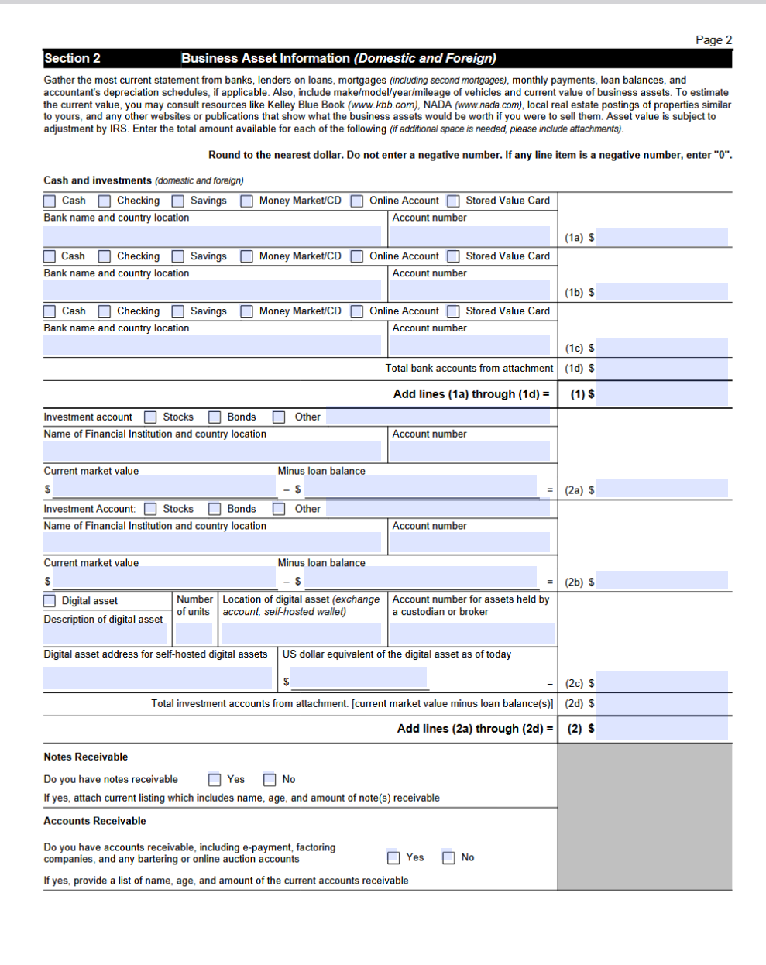

Slide 31
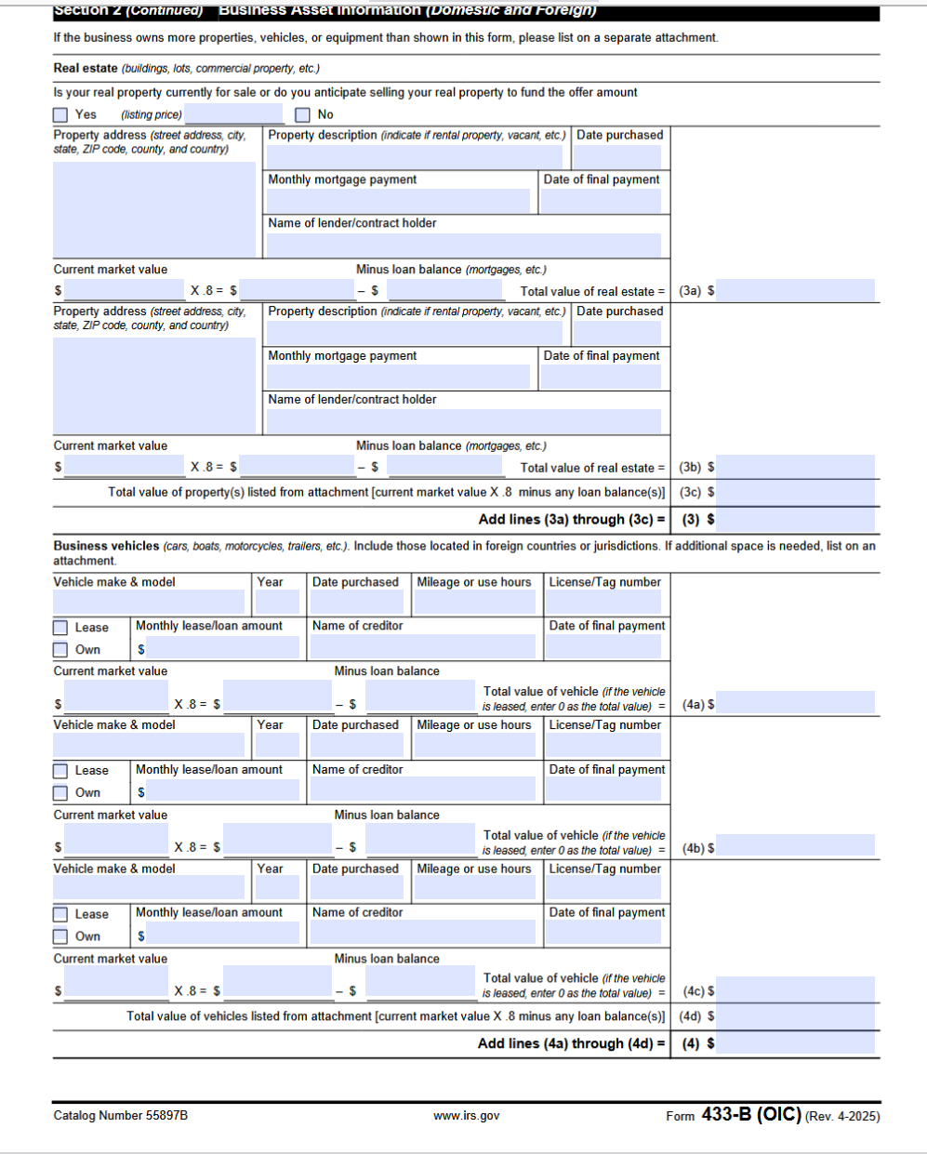

Slide 32
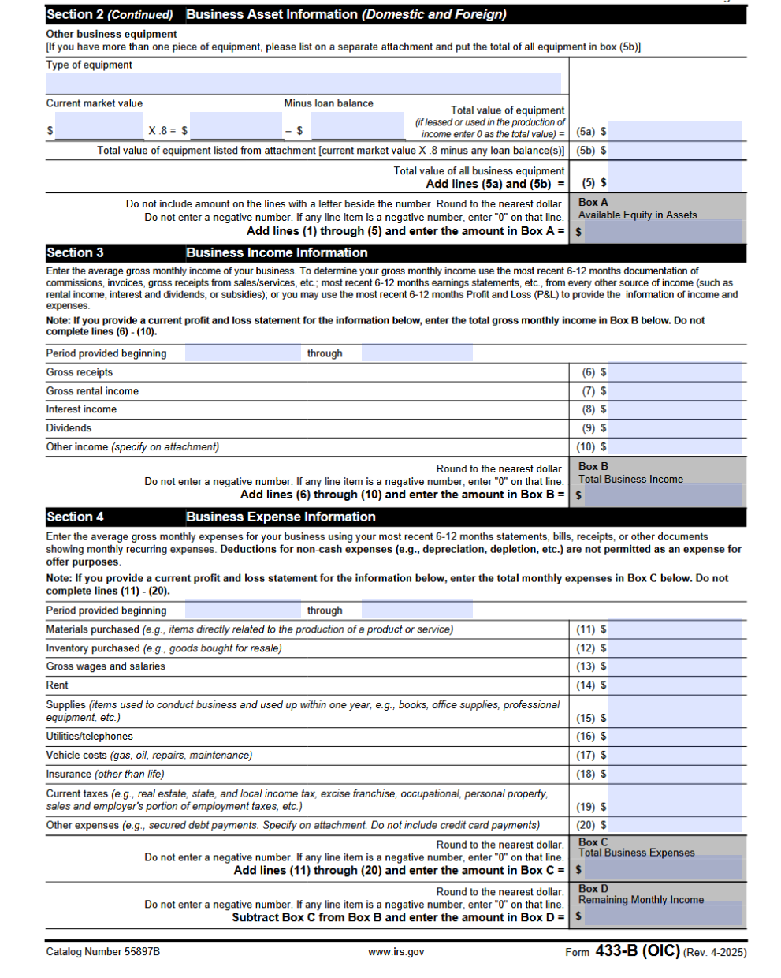

Slide 33
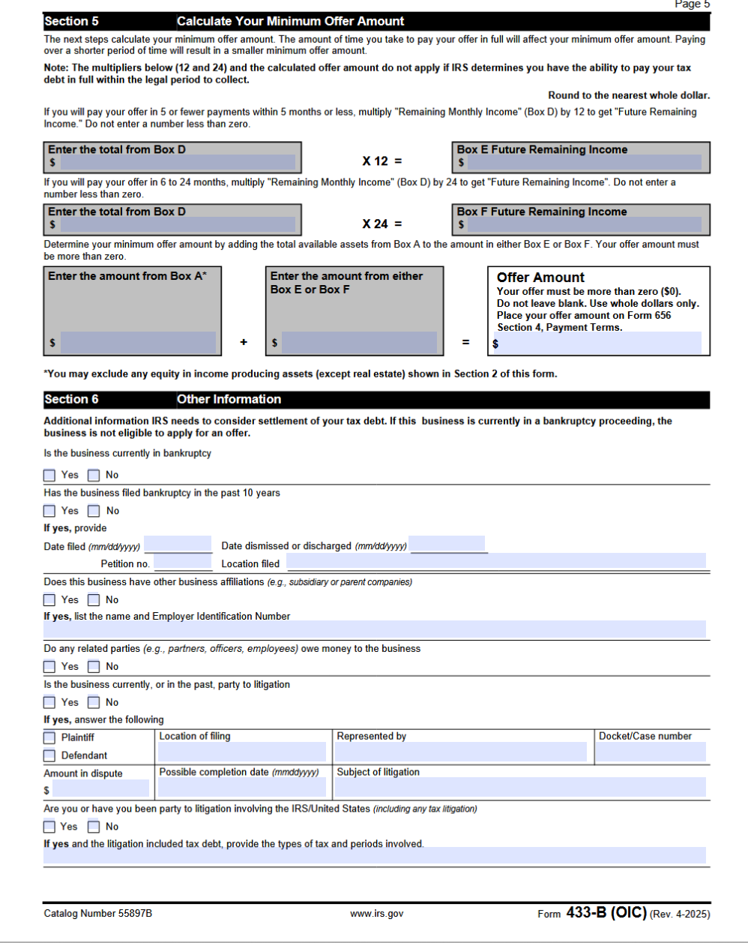

Slide 34
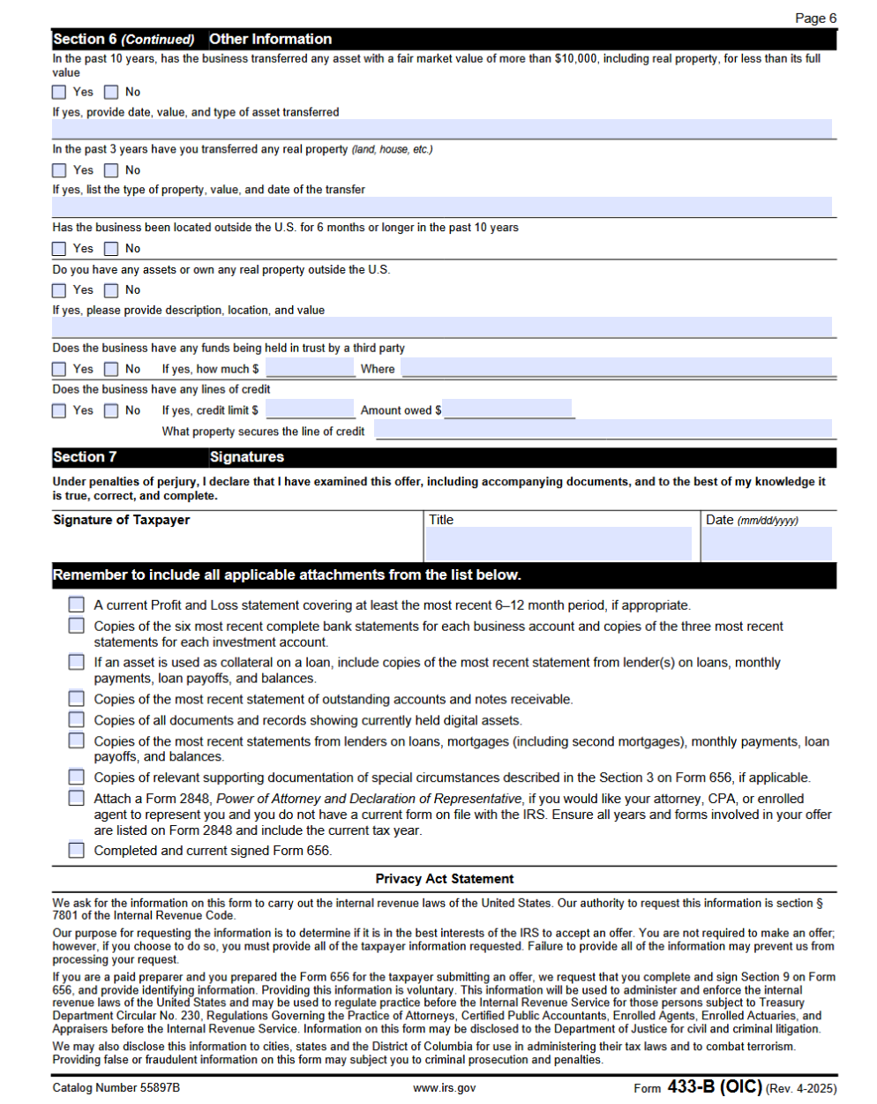

Slide 35
Review and Timeline
IRS acknowledges receipt in ~30 days
Review may take 6 – 12 months
Collection is paused during review
Appeals is available if rejected

Slide 36
If Accepted:
Must stay current on filing and paying for five years
IRS keeps any refunds for the year of acceptance
Failure to comply defaults acceptance

Slide 37
Common Reasons for Rejection
Offer is less than RCP
Missing documentation
Not current on filing and estimated payments

Slide 38
Most Common Form 656 Errors
Missing the required application fee and initial payment
Incomplete personal and financial information
Choosing the wrong reason for the offer
Incorrect offer amount or miscalculated RCP
Failing to list all tax debts and years owed
Not staying current with tax filing and estimated payments
Using an outdated version of Form 656

Slide 39
Most Common Form 656 Errors (cont)
Missing signatures or incorrect signature format
Not providing required attachments
Mailing the pasckage to the wrong IRS address

Slide 40
Recent Years’ Stats
Between 2015 and 2024, 499,095 OICs submitted – 183,407 accepted: 36.7% acceptance rate
2023 – 30,163 OICs submitted – 12,711 accepted: 42.1% acceptance rate
2024 – 33,591 OICs submitted – 7,199 accepted: 21.4% acceptance rate
Stats regarding categories not available
Taxpayer Advocate Service has criticized lack of transparency of OIC program

Slide 41
TRUST FUND RECOVERY PENALTY
IRC § 6672(a): Any person required to collect, truthfully account for, and pay over any tax imposed by this title who willfully fails to collect such tax, or truthfully account for and pay over such tax, or willfully attempts in any manner to evade or defeat any such tax or the payment thereof, shall, in addition to other penalties provided by law, be liable to a penalty equal to the total amount of the tax evaded, or not collected, or not accounted for and paid over.

Slide 42
Responsibility
Authority to sign checks
Authority to direct or control payroll
Ability to decide which creditors get paid
Role in preparing or signing tax returns (Form 941)
Ownership interest or corporate office
Ability to hire/fire employees

Slide 43
Wilfulness
Knew taxes were due and
Chose to use funds to pay other creditors
DOES NOT require:
Evil intent
Fraud
Personal benefit
DOES include:
Paying other bills
Ignoring IRS notices
Reckless disregard

Slide 44
Final Determination and Assessment
IRS identifies persons meeting both elements
Issues Letter 1153 and Form 2751 proposing TFRP
60 days to appeal
If no appeal, assessment is made

