Slide 1

New Tax OBBBA Changes Larry Marietta, CPA

Slide 2
The One Big Beautiful Bill: Individuals
The Affects of the OBBBA on Individual Taxpayers
Section 170 Charity Deduct • Strikes Personal Exemption • Wage Loss Limits
Section 163(h) Auto Interest • Standard Deduction • Alternative Minimum Tax (AMT)
Section 225 Overtime Comp • Section 151(d)(5) Senior Deduct • Trump Accounts
No Tax On Tips • Section 24(h) Child Tax Credit • ABLE Accounts
Section 129 Dependent Care • Section 199A QBI • 529 Plan
• Itemized Deduction Limit • Educator Expenses

Slide 3
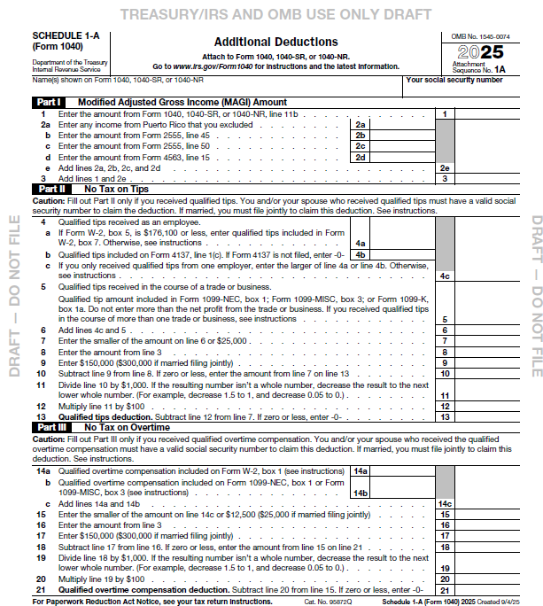
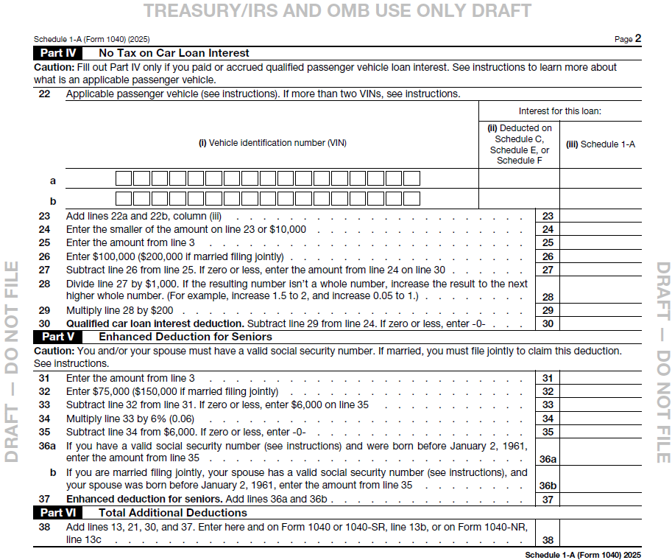
New Release of provisional IRS Schedule 1-A

Slide 4
§ 170 Charitable Contributions Below- and New Above-The-Line
Beginning 2026 Non-Itemizing Individuals are now allowed an above-the-line charitable deduction $1,000 Single ($2,000 MFJ)
Also 2026 Itemizing Individuals now must meet the floor threshold of 0.5% of AGI (was at 0%)
For all Individuals – the 60% cash contribution limit of AGI is made permanent
If your clients have intentions to give to charity and have no idea what charity to pick, advise your client on choosing Donor Advised Funds (DAFs)
Allows individuals to contribute to charitable fund and receive immediate tax deduction
The client recommends a charity
DAF then verifies the charity and makes the eligible grant on behalf

Slide 5
§ 163(h) Home Mortgage Interest & New Mortgage Insurance Premiums Below-The-Line
The OBBBA continues the limited interest deduction on home equity loans and reduced the total amount of deductible acquisition debt interest to $750,000 ($375,000 MFS) for mortgages taken after December 15, 2017
Still, to deduct interest on a home equity loan, must use the loan proceeds to acquire or improve a principal residence or a second residence
Starting in 2026, the OBBBA may allow you to deduct premiums paid for qualified mortgage insurance that covers home acquisition debt. The mortgage insurance contract must have been issued after 2006
Phaseout reduces 10% for every $1,000 above $100,000 AGI or $50,000 MFS
Considered part of your qualified residence interest deduction
For an unmarried individual or married joint-filing couple, the mortgage interest deduction will be completely phased out if your AGI is $110,000 or higher

Slide 6
New § 163(h)(4) Auto Loan Interest Above-The-Line
For 2025 Tax Year Auto loan interest Maximum Annual Deduction of $10,000 limited by MAGI threshold
Prior to OBBBA, personal auto loan interest was not deductible.
Reduced by $200 for each $1,000 MAGI Exceeds $100,000 ($200,000 MFJ)
Now, Personal loan interest on a qualified passenger vehicle paid is qualified interest
This means Individuals may deduct qualified interest paid on a loan used to purchase “qualified vehicle”, so long as for personal use and other eligibility met
“Taxpayer Eligibility” – Deduction available for both itemizing and non-itemizing taxpayers. The taxpayer must include the Vehicle Identification Number (VIN) of the vehicle on the tax return for any year when the deduction is claimed
“Reporting” – Lenders of qualified interest must file information returns with the IRS and furnish statements to taxpayers showing the total amount of interest received during the taxable year
“Guidance” – The IRS will provide transition relief for tax year 2025 for interest recipients subject to the new reporting requirements

Slide 7
Continued . . . New § 163(h)(4) Auto Loan Interest Above-The-Line
“Qualified vehicle” – A car, minivan, van, SUV, pick-up truck or motorcycle, with 1. gross vehicle weight rating of less than 14,000 pounds and 2. has undergone final assembly in US
Vehicle Identification Number (VIN) must be included on Tax Return
Important to determine if final assembly in US:
Information label attached to vehicle on dealer’s premises
VIN
“Qualified Interest” – Loan must originate after December 31, 2024. So, it is only for cars/loans purchased after the start of 2025 and thereafter
Loan must be used to purchase a new vehicle and not a used vehicle
The loan must secure a lien on the vehicle
No lease financing
No commercial use vehicles that is not used for personal purposes
No loan to finance fleet sales
Phase out for taxpayers with MAGI
Refinancing loan allowed only if first lien still applies and the new loan does not exceed the first loan

Slide 8
New § 225 Qualified Overtime Compensation No Tax On Overtime Above-The-Line
New above-the-line deduction beginning 2025 through 2028, individuals who received qualified overtime compensation may deduct the pay that exceeds their regular rate, i.e. the “half” portion of “time-and-a-half”
“Qualified Overtime Compensation”
What is defined and required by the Fair Labor Standards Act (FLSA)
Reported on a Form W-2, Form 1099, or other specified statement furnished to the individual
Does not include §224(d) qualified tips
Maximum annual deduction is $12,500 ($25,000 for joint filers)
Phaseout for taxpayers with MAGI over $150,000 ($300,000 for joint filers)
Reduced by $100 for each $1,000 over MAGI exceeding $150,000 ($300,000 MFJ)
MAGI is AGI increased by excluded from Gross Income §§ 911, 931, or 933
Taxpayer eligibility – deduction is available for both itemizing and non-itemizing taxpayers
Taxpayers must:
Include Social security number on return, and
File MFJ if married, to claim deduction
Reporting – employers and other payors are required to file W2 with the IRS (or SSA) & statements to taxpayers showing total amount of qualified overtime compensation per year

Slide 9
§ 224 No Tax On Tip Income, Above-The-Line
OBBBA allows employees and self-employed to deduct above-the-line 100% of tips up to $25,000 in the tax year
Allowed to taxpayers taking standard deduction
Allowed to taxpayers taking itemized deduction
Phase out for taxpayers with MAGI over $150,000 single ($300,000 MFJ) – reduced by $100 for every $1,000 over
Eligible tips are earned in occupations that “customarily and regularly” receive tips on or before Dec 31, 2024. IRS has published a list of these occupations, IR-2025-92 September 19, 2025.
Non-dollar benefits:
Lower employer-side payroll costs and simplified reporting
Improved morale and retention as net pay increases
Employers need to revisit
Point-of-sale tip collection process
Update payroll systems
Educate team on how this benefits them directly

Slide 10
IRC § 129 Dependent Care (Child Care)
Individuals (employees) see an Increase to Flexible Spending Account (FSA) on a pre-tax basis
For Individuals, OBBBA makes adjustments to Child and Dependent Tax Credit. Individuals may claim a credit up to 50% on eligible childcare expenses
Maximum expense limits ($3,000 for one child/dependent, $6,000 for two or more) remain the same
Employers may receive an increased tax credit to providing childcare services to employees
Increased to $500,000 (or $600,000 for eligible small businesses)
Credit percentage increase from 40% (or 50% for eligible small businesses) of qualified expenses
Also allows for credit claims when employers contract qualified third-party childcare providers or jointly own/operate childcare facilities

Slide 11
Permanent Strike to Personal Exemptions
Until later repealed and reenacted, the OBBBA makes permanent the strike to Personal Exemptions
TCJA made the strike to Personal Exemptions in 2017
Used to be able to take exemptions for spouses, dependents, children

Slide 12
Standard deduction
A fixed dollar amount that reduces taxable income for taxpayers who do not itemize their deductions.
The TCJA nearly doubled the standard deduction to simplify tax filing for many. The OBBBA is described as making TCJA increased amounts permanent, adjusted annually for inflation.
2025 Standard Deduction rates for 2025 are:
Single $15,000
Head of Household $23,625
Married Filing Jointly $31,500
Married Filing Single $15,750

Slide 13
Increase § 151(d)(5) Additional Senior Deduction
§151(d)(5) Senior Standard deduction is an allowed deduction for qualified individual taxpayers age 65 and older. Increase is $6,000 for Single, $12,000 for MFJ, from the previously $1,950, $3,100 respectfully. Adjusted for Inflation
Phase out for taxpayers with MAGI (Modified Adjusted Gross Income) over $75,000 ($150,000 for MFJ)
Qualified individual is a taxpayer age 65 at or before last day of tax year
Joint returns, taxpayer’s spouse, if age 65 before close of tax year
MAGI Limitation – reduced by 6% of every $1,000 of MAGI exceeding $75,000 ($150,000 MFJ)
MAGI means AGI increased by excluded Gross Income of §911, 931, or 934
Requires SSN for claimants
Available for both Itemizing and non-itemizing taxpayers. It is a below-the-line deduction

Slide 14
Child Tax Credit § 24(h) and Additional Child tax Credit Amended
The OBBBA is extending the higher credit amount and the higher phaseout thresholds, with a new increase from $2,000 to $2,200 per child, indexed for inflation.
The credit is available for children under 17 starting 2025 tax year
Permanent requirement for the child and at least one parent to have a valid SSN
Same eligibility requirements apply
The Additional Child tax Credit, also known as the maximum refundable portion of the Child tax Credit, is increased from $1,500 to $1,700, adjusted annually for inflation
Must Have earned income exceeding $2,500 (set to increase to $3,000 in 2026)

Slide 15
Qualified Business Income Deduction § 199A
The deductible percentage of QBI did not change and is permanently at 20% allowable to non-itemizers
QBI applies to Sole Proprietors (Sch C), Partnerships, S Corporations, LLCs taxed as any aforementioned entity (not a C Corporation), and certain trusts and estates
No change to what is SSTB and non-SSTB
SSTB Phaseout between $197,300 to $247,300 for single filers ($394,600 to $494,600 MFJ)
Non-SSTB phaseout stays the same with greater of wage and property limitations and same thresholds
New minimum $400 QBI Deduction to qualifying taxpayers
If the QBI deduction would have been reduced to a small amount (or zero), the law guarantees the minimum QBI deduction of $400 if the taxpayer’s qualified business income is at least $1,000
Deduction is indexed for inflation

Slide 16
Itemized Deduction Limit
The OBBBA makes a temporary change to the TCJA cap to State and Local Taxes (SALT) deduction from $10,000 to $40,000, adjusted for inflation
Fully eligible to taxpayers with MAGI under $500,000
Decrease (30%) 30 cents for every dollar over MAGI beyond $500,000
Floor of $10,000 allowed SALT deduction, once MAGI reaches $600,000
Makes permanent the elimination of miscellaneous itemized deductions
A new limitation to those taxpayers in the top tax bracket are to receive only a 35% itemized deduction limit
For every dollar in itemized deductions for those taxpayers in a 37%, may only receive a tax savings of up to 35 cents
Itemized Deductions still includes specific expenses, such as mortgage interest, charitable contributions, and state and local taxes, that can be subtracted from AGI

Slide 17
Gambling Wage Loss Limitations OBBBA
Effective January 1, 2026, the OBBBA has updated the rules for deducting gambling losses. Prior to the OBBBA, gambling losses were deductible up to the amount of gambling winnings. The OBBBA is described as making a key change by limiting the deduction for gambling losses to 90% of gambling winnings
This can result in a tax liability even for individuals who break even for the year
Section 165(d): Governs the deduction for wagering losses
Phantom Income: Taxable income that is not a real or tangible gain, such as the 10% of winnings that cannot be offset by gambling losses under the OBBBA (see example on next slide)

Slide 18
Gambling Wage Loss Limitations OBBBA - Example
A gambler with $4,500,000 in winnings would need $5,000,000 in losses to completely offset their winnings and achieve a zero tax bill
A gambler with $8,000,000 in winnings and $8,000,000 in losses would only be able to deduct $7,200,000 (90% of losses). This would result in a taxable net profit of $800,000, which would be subject to federal income tax
For the current tax year, a single or married-filing-jointly taxpayer with an $800,000 net profit would likely fall into the highest tax bracket (37%). This would result in a significant tax liability of $296,000 on an activity that had a net profit of zero

Slide 19
Alternative Minimum Tax (AMT)
The TCJA temporarily increased the AMT exemption and raised the income thresholds of exemption phase out to $500,000 single ($1,000,000 MFJ)
The OBBBA made the TCJA increased exemption phase out amounts permanent but changed the AMT Exemption amounts to $88,100 single ($137,300 MFJ), and increasing the phase out rate from 25% to 50%
AMT may occur when a client has significant “preference items” or “adjustments”. Such as
Incentive Stock Option (ISO) Exercises – the Bargain element may trigger AMT
Accelerated Depreciation
State and Local Tax (SALT) Deductions – Look out for this with increased $40,000 limit

Slide 20
§ 530A Trump Accounts
The OBBBA has created this is new savings vehicle which is a type of tax-advantaged account for children, structured similarly to an IRA, with specific rules on contributions and withdrawals
The child must be born between January 1, 2025, and December 31, 2028
The U.S. Government makes an initial $1,000 deposit and an individual (child) has an annual contribution limit of $5,000, indexed for inflation
The contributors to the account may be parents, family members, and others, but these contributions are not tax-deductible like a contribution to a traditional IRA
Employers may contribute up to $2,500 per year and are tax-free to the employee. This is counted toward the $5,000 cap
Earnings in the account are tax free
Distributions restricted until the child turns 18. Any distributions after 18 and before 59 ½ are penalized 10%, like IRAs

Slide 21
ABLE Accounts
OBBB allowed an eligible working individual with a disability to contribute their own income to an ABLE account above the annual gift tax exclusion limit, and it made ABLE account contributions eligible for the Saver's Credit
Contributions may also be made by anyone within the gift exclusion amount, $19,000 in 2025
The OBBBA expanded the age of disability eligibility from before age 26 to before age 46
Qualified Disability Expenses are:
Education
Housing (rent, mortgage payments, etc.)
Transportation
Employment Training & Support
Health, prevention, and wellness expenses
Assistive technology & personal support
Financial Management & Administrative Services

Slide 22
529 Plans Educational Expenses
The OBBBA increased the tuition from $10,000 to $20,000 per year in tuition and for elementary or secondary public, private, or religious schools
The OBBBA expands the tax exclusion to K-12 expenses:
Curriculum materials and books
Online educational tools and subscriptions
Tutoring services
Fees for standardized tests
Dual-enrollment fees for college courses in high school
Education therapy for students with disabilities
A new change is the employer-provided educational assistance to include student loan payments within the current limit of $5,250, indexed for inflation

Slide 23
New Educator Expenses
The OBBBA eliminates the $300 annual limit for those who choose to itemize their deduction
Those who take the standard deduction may now take an above-the-line deduction limited to $300 single ($600 MFJ)
Expands the scope of expenses to include athletic supplies for physical education teachers, coaches, and sports administrators

Slide 24
The One Big Beautiful Bill: Business
Introductory, WOTC, & Employer-provided Meals • § 461(l) Excess Business Loss Limitation
1202 Qualified Small Business Stock • §163(j) Business Interest Limitation
§ 168(k) Bonus Depreciation & § 179 Expense • Form 1099 Reporting Threshold
§ 174A Research & Experiment Expense • Green Clean Commercial Vehicles
Qualified Business Income Section § 199A • Manufacturing Credits
Employer Paid Leave Credit § 45S • Overtime Pay Exemption
§163(j) Business Interest Limitation • Other Employee Benefit Changes
Overtime Pay Exemption

Slide 25
OBBBA Business
The TCJA made business provisions beginning 2017 which scheduled to sunset December 31, 2025
Provisions like Qualified Business Income, Bonus Depreciation, Credits for Green Investments, & more
The OBBBA set out to make permanent most but not all of the TCJA provisions
However, not all OBBBA changes were positive, such as
Employer-provided Meals to become 100% nondeductible
Previously Employee meals provided on-site for the benefit of the employee was 50% nondeductible
Employer-provided snacks and other fringe benefits are no longer deductible
Do not confuse with business meal expense (these are still 50% deductible)
Work Opportunity Tax Credit will no longer be available
Starting January 1, 2026 the WOTC is out of the picture
It is a credit available to employers who hire workers from certain “targeted groups”, i.e. veterans and people receive certain public assistance benefits

Slide 26
Section 1202 Qualified Small Business Stock
C Corporation Qualified Small Business Stock is continued in the OBBBA
Cannot be S corporation, may be LLC taxed as C Corporation
Stockholders may include Pass Through Entity (even S Corp), Individual, and Trusts
Still required at least 80% of corporate assets used in active qualified trade or business
“Substantially all” is about 80%
Must be initial stock of C Corp
New provisions increase the gross-assets cap rule
Previously was $50 million
Starting in 2026 it is at a $75 million
New provisions present tiered-system of holding period – no longer “five-year must”
Stock owners with stock at least three years – 50% eligible gain exclusion
Stock owners with stock at least four years – 75% eligible gain exclusion
Stock owners with stock at least five years – 100% eligible gain exclusion
New provision increase the gain exclusion amount
Previously was $10 Million or 10X taxpayer’s basis in stock
Starting in 2026 it is $15 Million or 10X taxpayer’s basis in stock

Slide 27
Bonus Depreciation
States may require partial or total add back of federal bonus depreciation
The OBBBA makes permanent the 100% bonus depreciation for “qualified property” placed “in service”, eliminating the scheduled phase-down
TCJA introduced Phase down of Bonus Depreciation to be 80% for 2023, 60% for 2024, 40% for 2025, 20% for 2026, and 0% thereafter. The OBBBA’s effect will repeal the phase-down effect and introduce the 100%
“Qualified Property” – New and used property based on a broad class of tangible business property with a recovery period of 20 years or less.
Used property qualified as long as the property was not previously used by purchaser
Generally, machinery, equipment, computers, vehicles, and land improvements (must be depreciable under MACRS)
“In Service” - This property must be placed in service after January 19, 2025.

Slide 28
Continued …. Bonus Depreciation
OBBBA introduces a new 100% deduction for "qualified production property" (non-residential real property used in manufacturing)
Qualified Production Property is building property typically excluded from bonus depreciation
Must be used as integral part of qualified production activity (manufacturing, production)
Placed in service in United States or U.S. Possession (supports U.S. Manufacturing)
Have original use commence with taxpayer
Have construction begin after January 19, 2025 and before January 1, 2029
Be designated by election
Be placed in Service before January 1, 2031
Leased property does not qualify, and cannot include portions with nonproduction purposes

Slide 29
Summary Table of Eligible Property for 2025 Bonus Depreciation
Asset Type | Eligible for 100% Bonus Depreciation in 2025?
Tangible personal property (20 years or less) | Yes
Computer software (IRC § 167(f)(1)) | Yes
Water utility property | Yes
Qualified film, TV, live theatrical productions | Yes
Certain fruit/nut plants | Yes
Used property (if not previously used by taxpayer) | Yes
Qualified production property (new OBBBA) | Yes (if all criteria met)
Nonresidential real property (39-year) | No (except for qualified production property)
Property required to use ADS | No
Property acquired under pre-1/20/2025 contract | No (for 100% bonus)

Slide 30
§ 179 Expense
States may require partial or total add back of § 179 Expenses
§ 179 Expensing: The maximum § 179 deduction limit has been increased to $2.5 million, and the phaseout threshold has been raised to $4 million, both of which are adjusted for inflation annually.
§ 179 expensing is limited to the amount of taxable income generated
Net losses may not be generated by 179 expense
Cannot be used to offset income from passive activities or non-business sources (investment income)
Applicable only against income from the trade or business with meaningful participation
Can be carried forward if any 179 expense is in excess to business income limitation

Slide 31
§ 174A Research & Experiment Expense
TCJA Required 2022-2025 taxpayers to capitalize R&E Section 174 and amortize over 5 or 15 years
OBBBA introduces New § 174A applying to tax years after Dec. 31, 2024, to deduct all domestic R&E during the tax year, while foreign R&E must be capitalized and amortized over 15 years.
The election to capitalize domestic R&E and amortize ratably over a period no less than 5 years is still available
Short tax years beginning after Dec. 31, 2024, and ending before July 4, 2025, must make a change of accounting method, on a modified cut-off basis with a § 481(a) adjustment, and accounting for only unamortized domestic R&E paid or incurred during short tax year
Small Business Taxpayers (average annual gross receipt less than $31M) for the first tax year beginning after Dec. 31, 2024, may retroactively apply § 174A to domestic R&E paid or incurred during tax years beginning after Dec. 31, 2021.
Each affected tax year’s tax return must be amended.
The amended return must conform to § 280C(c)
Rev. Proc. 2025-28

Slide 32
Qualified Business Income 199A Deduction
The OBBBA makes permanent QBI 199A after 2025
Basic Limitation is still lesser of 20% of QBI or 20% of taxable income (less net capital gains)
No change to W-2 Wage and Qualified Property Tests at high income levels
Same Specified Service Trade or Business (SSTB)
SSTBs are law, health, consulting, financial services, professional practices
Higher Phase-In ranges
SSTB restrictions increase from $50,000 to $75,000 for Single Filers and from $100,000 to $150,000 for Joint Filers
Higher Phase-Out Ranges
SSTB Phase-out expands from $394,600-$494,600 to $394,600-$544,600
New minimum Deduction of $400 if QBI greater than $1,000

Slide 33
QBI Pre- and Post-OBBBA Comparison
Feature | Pre‑OBBBA (through 2025) | OBBBA (2026 and after)
Deduction rate | 20% of QBI (subject to limits)​ | 20% of QBI (same formula)​
Sunset | Expires after 2025​ | Permanent, no scheduled sunset​
Phase‑in range (single) | $50,000 over threshold​ | $75,000 over threshold, indexed​
Phase‑in range (married joint) | $100,000 over threshold​ | $150,000 over threshold, indexed​
Minimum deduction for active QBI | None​ | $400 if active QBI ≥ $1,000, indexed​
SSTB treatment at high income | Deduction phases out and ends within narrower band​ | Same rules, but over wider income band so partial benefit lasts longer​

Slide 34
Employer Credit For Paid Family and Medical Leave
General business tax credit under IRC Section 45S
OBBBA Makes permanent for years after 2025.
Its purpose: encourage employers to offer paid leave for reasons covered by the Family and Medical Leave Act (FMLA)
A few covered FMLA reasons:
Caring for a new child
Seriously ill family member (Spouse, child, or parent)
Employee’s own serious health condition
Eligibility requirements:
Employers have written policy providing at least two paid weeks of leave annually
To qualifying employees
Paying at least 50% of normal wages during leave

Slide 35
§ 461(l) Excess Business Loss Limitation
Introduced by the TCJA and made permanent by OBBBA
Restricts amount of business losses a non-corporate taxpayer may deduct in a single tax year to offset non-business income determined by calculation and threshold. Any excess is converted to a Net Operating Loss (NOL)
“Final hurdle” to deduct losses to partnerships or s corporations, after considering basis limitation, at-risk limitation, and passive activity loss
Excessive business loss calculation:
Total deductions from all trades or businesses exceed total gross income and gains from those trades or businesses, plus threshold $321,000 Single ($642,400 MFJ) for 2026.
Business deductions and income-calculation aggregates all deductions from gross income/gains from all trades or businesses operated by taxpayer
Wages excluded, income from being an employee is not considered business income

Slide 36
163(j) Business interest expense limitation
Business Interest Expense Limitation was previously based on Earnings Before Income Taxes (EBIT)
Now starting January 1, 2025 the OBBBA permanently restores Earnings Before Income Tax Depreciation and Amortization (EBITDA)
Means a decreased Adjusted Taxable Income (ATI) and a higher interest deduction ceiling (of 30% ATI)
EXAMPLE: Company A has taxable income of $1,000,000, depreciation of $200,000, and interest expense of $400,000.
Under PRE-OBBBA EBIT rules: ATI = $1,000,000, 30% limit = $300,000, only $300,000 of interest is deductible.
Under OBBBA EBITDA rules: ATI = $1,000,000 + $200,000 = $1,200,000, 30% limit = $360,000, now $360,000 of interest is deductible.
Result: Company A can deduct $60,000 more in interest expense under OBBBA.

Slide 37
Form 1099 Reporting Threshold
The OBBBA restores the previous threshold for 1099-K to $20,000 gross payments and more than 200 transactions in a calendar year
Previously this was a $600 threshold, causing confusion to casual sellers of Amazon, etc.
Was at the level set by OBBBA last in 2023
The OBBBA has introduced a new floor to contractors’ 1099-NEC and 1099-MISC
Reporting threshold are increased from $600 to $2,000, indexed for inflation starting in 2027
Change in reported threshold does not mean 1099-K income is not reportable on tax return

Slide 38
OBBBA Clean Commercial Vehicle Credits
OBBBA takes out the Commercial Clean Vehicle Credit IRC Section 45W
Credit for commercial clean vehicles is cut off for vehicles acquired after September 30, 2025
Based on lesser of 30% of vehicle’s cost (15% hybrids) or the incremental cost compared to conventional vehicle with cap of $7,500 for light-duty vehicles and $40,000 for heavy-duty vehicles
Any projects already under contract should be aim to acquisition date by this date
However, “acquired” vehicles bound to written contract plus downpayment made before but placed in service after September 30, 2025 may qualify
OBBBA takes out the Alternative Fuel Refueling Property Credit Section 30C
Credit for installing qualified alternative fuel refueling property ends for property placed in service after June 30, 2026 (was originally for 2032 per the Inflation Reduction Act)
I.e. Electric Vehicle Charging Stations

Slide 39
Changes to Manufacturing
Important provision from OBBBA is deduction for Qualified Production Property (QPP) used in Qualified Production activity
QPP is a portion of nonresidential real property used by taxpayer as an integral part of a qualified production activity
Qualified Production Activity is the manufacturing, production or refining of tangible personal property resulting in substantial transformation of the property comprising the product.
Meaning, transforming materials or property into a product
Mentioned in the Bonus Depreciation section
Newly constructed and qualifiable nonresidential real property for the qualified production activity may be depreciated 100%
No office spaces or administration office
Must be in service before January 1, 2031 and construction after January 19, 2025 and before January 1, 2029

Slide 40
Overtime Pay Exemption
Employers continue compliance with existing wage and hour laws and the Fair Labor Standards Act (FLSA)
How Overtime payment is the same
All non-exempt employees receive 1.5 times (premium) the regular rate of pay for all hours worked over 40 in a workweek (FLSA)
Employers continue to withhold FICA and applicable state tax withholdings
How Overtime payment is new
Employers are required to track and separately report “qualified overtime compensation” on W2
“Qualified Overtime” – only to the Premium Portion of the FLSA-required overtime, not overtime mandated solely by state law or company policy
IRS 2025 Transition Period allows penalty grace to employers failing to separately report the qualified overtime
Must file complete and correct returns otherwise
IRS released draft 2026 Form W-2 with new code for Box 12 (Code TT) for mandatory separate reporting

Slide 41
Other Employee Benefit Changes
Student loan employer payback plans: Employers may continue to pay or reimburse up to $5,250 employee per year toward student loans on a tax-free basis.
The exclusion becomes permanent starting in 2026 and the amount will be for inflation
Retirement Plans – The OBBBA increases contribution limits for retirement plans
Defined contribution limits increased from $69,000 in 2024 to $70,000 in 2025.
CAUTION The OBBBA extended the IRS Statute of Limitations for auditing Q3 and Q4 Quarter 2021 Employee Retention Credit (ERC) claims from Five Years to Six Years after the later of
1) date on which original payroll tax return was filed for ERC claim or
2) date the ERC claim was filed (albeit amended)
New Due Diligence requirements for ERC Promoters
Requirements similar to earned income, child, and education credits
When related to Q3 or Q4 2021 ERC claims or refunds
OBBBA prevents the IRS from allowing or refunding ERC claims for Q3 and Q4 of 2021 filed after January 31, 2024

Slide 42
Continued… Other Employer Benefits
IRC Section 129 Dependent Care (Child Care)
Employers may receive an increased tax credit to providing childcare services to employees
Increased to $500,000 (or $600,000 for eligible small businesses)
Credit percentage increase from 40% (or 50% for eligible small businesses) of qualified expenses

Slide 43
Thank you!
Larry Marietta, CPA
317-216-1040
www.mariettacpa.com

