Slide 1

Net Unrealized Appreciation and Restricted Stock Units
Anthony Pugh, JD, MBA, CPA

Slide 2
Net Unrealized Appreciation (NUA)
Key Points:
Pay capital gains tax instead of ordinary income tax on qualified account distribution
Applies only to employer stock in a qualified retirement account
Financial advisors are divesting the stock without knowing about the opportunity for tax savings, so you need to have these discussions well before retirement age
Watch your Lilly, Amazon, UNH, etc employees, especially ones who have worked there for a long period of time or many years ago.

Slide 3
Net Unrealized Appreciation (NUA)
Net Unrealized Appreciation (“NUA”) is the excess of the fair market value (FMV) of employer stock held in a qualified plan over the cost basis in those shares on the date of a qualifying lump-sum distribution.
NUA = FMV – Basis (the Unrealized Gain)
Basis is the cost or value of shares when purchased in the plan
What is Net Unrealized Appreciation (NUA)?
In tax it is the concept applicable to employer stock held inside an employer-sponsored retirement plan, possibly a 401(k)
Key Benefit: The NUA portion receives long-term capital gains treatment upon subsequent sale, regardless of the holding period after distribution. This is a crucial exception to the general rule that all pre-tax distributions from a qualified plan are taxed as ordinary income.

Slide 4
NUA and Income Taxation (Pre-Exercise)
To the Employee:
No Tax Burden: As long as the stock remains within the retirement plan, the employee does not owe any income tax on the appreciation.
Contributions: Employee and Employer contributions to the plan are taxed according to standard retirement plan rules, i.e. Traditional 401K
To the Employer:
Deductible Expense: The employer's contributions of company stock to the retirement plan are generally a deductible business expense.
No Tax Burden: The employer does not recognize any taxable income or loss on the appreciation of the stock within the plan.

Slide 5
NUA and Income Taxation (Pre-Distribution)
During Plan Accumulation:
The appreciation of employer securities within the plan is tax-deferred
No taxable event occurs for either the employee or the employer solely due to the appreciation of the securities
Aligns with Tax Code principle of recognized versus realized gains
Cost Basis Determination:
The plan's cost basis is purchase price at the time purchased within the plan or the value of the stock on the date the shares were contributed to the plan. This includes both employer and employee contributions used to purchase the stock.
The plan administrator is responsible for tracking and reporting this cost basis.

Slide 6
NUA and Income Taxation (Post-Exercise)
Triggering Event: The NUA tax benefit is only realized when the employee takes a “lump-sum distribution“ of the stock from the retirement account.
"lump-sum distribution" means the entire balance is distributed within a single calendar year.
The IRS treats all retirement plans maintained by the same employer as a single (like) plan
Taxation to the Employee:
Cost Basis: The portion of the distribution equal to the stock's cost basis is taxed as ordinary income.
NUA Gain: The net unrealized appreciation (the difference between market value at distribution and the cost basis) is taxed at the long-term capital gains rate. This is the primary tax savings benefit.
Future Gain/Loss: Any future appreciation of the stock after it has been distributed from the retirement plan is subject to regular capital gains rules.

Slide 7
NUA and Income Taxation (Post-Distribution)
Lump-Sum Distribution Requirement: To qualify for NUA treatment, the distribution of employer securities must be part of a lump-sum distribution.
Lump-Sum Definition: A distribution of the employee's entire balance from all of the employer's qualified plans of a single type (e.g., all 401(k) plans, all profit-sharing plans) within one tax year.
Taxation upon Distribution:
Cost Basis: The plan's cost basis is taxed as ordinary income in the year of distribution. This may also be subject to the 10% early withdrawal penalty under IRC Section 72(t) unless an exception applies (e.g., separation from service after age 55, or age 59½).
NUA Portion: The NUA is not included in gross income at the time of distribution. Instead, it receives long-term capital gains treatment when the securities are later sold.

Slide 8
NUA Requirements of Distribution
Lump-Sum Distributions of NUA must begin on qualified event
Separation from Service
Reaching Age 59 ½
Death
Disability
Lump-sum distribution is required
Retirement plan must be empty within calendar year of lump sum distribution
Caution to not have NUA status revoked by missing the date

Slide 9
Careful of Distribution Options
Strategies for distribution of Employer stock and cash contributions
For NUA treatment, the employer stock must be part of a lump-sum distribution in one tax year
Send employer stock to a taxable brokerage account and roll the non-stock portion of the plan (funds, ETFs, etc.) to an IRA at the same time, preserving tax deferral on the rest
Sell Stock Units in lots with lower cost basis (higher NUA) and rollover remaining Stock Units with higher cost basis (lower NUA) into IRA – IRC Section 402(c)(2)(b)
Taxed portion will be the cost basis of first amount distributed from retirement plan that includes employer securities in the plan
What to not do:
Do not sell employer stock while held in the qualified plan
Do not roll employer stock itself into an IRA, or else NUA treatment is permanently forfeited and all later distributions will be taxed as ordinary income
Be careful with partial distributions in earlier years; before the triggering event can prevent a later distribution from qualifying as a lump sum for NUA purposes
Do not initiate distributions in November or December
Runs risk distributions flowing into next calendar year

Slide 10
Example of sale of Stock Units
Stock A (5000 Shares)
Value $600,000 Cost Basis $300,000
Lot 1 – 3,000 shares Cost Basis $50,000 – make NUA Lot 2 – 1,000 shares Cost Basis $100,000 – rollover to IRA Lot 3 – 1,000 shares Cost Basis $150,000 – rollover to IRA
Recent shares have higher cost basis – may not make sense to elect NUA on all shares as would owe ordinary income taxes on $300,000 of cost basis. Instead do In-kind rollover to IRA on some of the higher cost basis which have higher cost basis because of being later stock lots.
Then only taxed on $50,000 of Lot 1, equal to $16.67 per share cost basis ($50,000/3,000)
$120 Per share 3,000 shares = $360,000 FMV cost basis $50,000 and NUA of $310,000

Slide 11
Form 1099-R Reporting
The plan administrator reports the distribution on Form 1099-R.
Box 1 (Gross Distribution): Will include the full fair market value of the distributed securities.
Box 2a (Taxable Amount): Will show the cost basis of the securities.
Box 6 (Net Unrealized Appreciation): Will report the NUA amount, which is the difference between Box 1 and Box 2a for the distributed stock.
NUA = FMV – Cost Basis
Box 7 Distribution Code: If under 59 ½ and no exception, 10% early penalty shown as Distribution

Slide 12
Benefits to the Employer
Employee Retention: Offering company stock in the retirement plan can be a powerful tool to attract and retain key employees. It aligns employee interests with the success of the company.
Reduced Cash Outlay: Instead of cash contributions, the employer can contribute company stock, which can help with cash flow.
Tax Deductions: Employer contributions to the plan are a tax-deductible expense.

Slide 13
Benefits to the Employee
Significant Tax Savings: The biggest benefit is the ability to pay the lower long-term capital gains tax rate on a potentially large portion of their retirement nest egg, rather than the higher ordinary income tax rate.
Consider the current ordinary income tax rate compared to your expected long-term capital gains rate; NUA is more attractive the bigger this gap and the larger the NUA portion versus the basis
Can send employer stock to a taxable brokerage account and roll non-stock portion of the plan (funds, ETFs, etc.) to an IRA at the same time, preserving tax deferral on the rest.
Control over Investments: Once the stock is distributed, the employee has full control over when to sell it. They can choose to hold it for further appreciation or sell it immediately.

Slide 14
Example of NUA Taxation
Let's see how NUA can save you money.
Assumptions: For this example, let's assume a 24% ordinary income tax rate and a 15% long-term capital gains tax rate. State tax rates may still apply.
NUA Cost-Savings Calculation:
Event |  | Cash Value
Initial Contribution | Employer contributes company stock to your 401(k) | $50,000
Growth in 401(k) | Stock grows to a fair market value of $200,000 | $150,000 (NUA)
Distribution | You take a lump-sum distribution | $200,000
Ordinary Income Tax | Taxed on the cost basis ($50,000) | $50,000
Long-Term Capital Gains Tax | Taxed on the NUA portion ($150,000) | $150,000
Total Taxable Income | Total value subject to tax | $200,000
Tax Savings | Tax rate difference (e.g., 24% ordinary vs. 15% LTCG) | $13,500 in savings
Ordinary tax if non-NUA: $150,000×24%=$36,000
Actual: Long-term capital gains tax: $150,000×15%=$22,500
Actual Tax Savings: $36,000−$22,500=$13,500

Slide 15
Advanced Tax Implications and Considerations
Post-Distribution Gains: Appreciation in the securities after the lump-sum distribution is subject to standard capital gains rules based on the new holding period.
If sold within one year distribution: Short-term capital gain
If held for more than one year: Long-term capital gain
Gain attributable to the NUA not taxed at the time of the receipt is Long-term capital gain, regardless of holding period after distribution
Losses: If the distributed stock's value falls below the plan's cost basis, the NUA benefit is lost, and the employee may be able to claim a capital loss.
Beneficiary Treatment (IRD):
NUA is considered “income in respect of a decedent” (IRD) under IRC Section 691.
Upon the death of the employee, beneficiaries who inherit the securities (stock) will be taxed on the NUA at the long-term capital gains rate when they sell the stock.
The appreciation after the date of distribution receives a step-up in basis at the date of death (pro-taxpayer).

Slide 16
NUA vs. IRA Rollover (Strategic Analysis)
Lump-Sum Distribution with NUA:
Pros: The potential for a significant portion of the assets to be taxed at the lower long-term capital gains rate. Avoids Required Minimum Distributions (RMDs) on the distributed stock.
Cons: The cost basis is immediately taxable as ordinary income, potentially pushing the taxpayer into a higher bracket. Concentration risk in a single security (stock).
Traditional IRA Rollover:
Pros: Allows for greater diversification. No immediate tax liability on any part of the distribution. Capital gains/dividends within the account are tax deferred.
Cons: All future distributions, including the appreciated value of the stock, are taxed as ordinary income. The NUA tax benefit is irrevocably forfeited.

Slide 17
A Numerical Analysis
This slide shows when the NUA strategy is most beneficial. It's not a one-size-fits-all solution, and a detailed calculation is critical.
Variable | Description | Scenario 1: NUA is Better | Scenario 2: IRA Rollover is Better
Current Tax Rate (Ordinary Income) | The rate at which the cost basis is taxed. | High rate (e.g., 32%) | Low rate (e.g., 12%)
Future Tax Rate (Ordinary Income) | The rate at which IRA distributions will be taxed. | High rate in retirement. | Low rate in retirement.
Capital Gains Rate | The rate on the NUA. | Low rate (e.g., 15%)
NUA as a % of Total Value | The higher this is, the better NUA looks. | High percentage (e.g., 70%+) | Low percentage (e.g., <50%)
Future Appreciation | Appreciation expected after distribution. | High future appreciation. | Low or negative future appreciation.
Cost Basis | The portion taxed as ordinary income. | Low cost basis | High cost basis
Client Age | Determines if penalties apply. | Over 59½ or ≥55 and separated from service. | Under 59½.
Final Analysis: The NUA strategy is most advantageous when there is a significant NUA percentage and the taxpayer expects to be in a higher ordinary income tax bracket in the year of distribution than their expected long-term capital

Slide 18
NUA in Retirement Account vs. Brokerage Account
Retirement account benefits in dividends and capital gains are not taxed when received each year compared to brokerage account
Cost trade-off – every dollar distributed from pre-tax account is taxed at ordinary tax rates
Tax may be higher on income tax than capital gains and ordinary dividend rates
Careful of effective tax rate at the later date of distribution
Brokerage Account benefits in dividends and capital gains are taxed at favorable tax rates at the present time received
Moving to a brokerage account – securities must be moved “in-kind”
Cannot sell securities, move cash, and buy back shares

Slide 19
Restricted Stock Units (RSU)s
What Are RSUs?
Restricted Stock unit (RSU) is a form of equity compensation issued to employees and other service providers
It is a promise from employer to grant employee shares of company stock (or cash equivalent) on future date
Restrictions must be met, the event of meeting restrictions and granting the shares is called “vesting”
RSU is an alternative to stock options (ISO or NSO)
No payment is due from employee at vesting, only the applicable tax
Used as part of employee compensation and retention

Slide 20
RSU Vesting and Conditions
Vesting conditions within RSU agreement may be:
Time-Based, stay at company certain timeframe
Milestone-based, company goals like IPO, to be acquired, or complete performance milestone
Single Trigger or Double Trigger RSUs
Single – RSUs have only one type of vesting condition
Double – RSUs have two types (usually time-based and milestone-based)
Once RSU is vested it must be settled
Settlement is actual conversion of RSU into shares
Sometimes this happens at once
Other times settlement date is separate

Slide 21
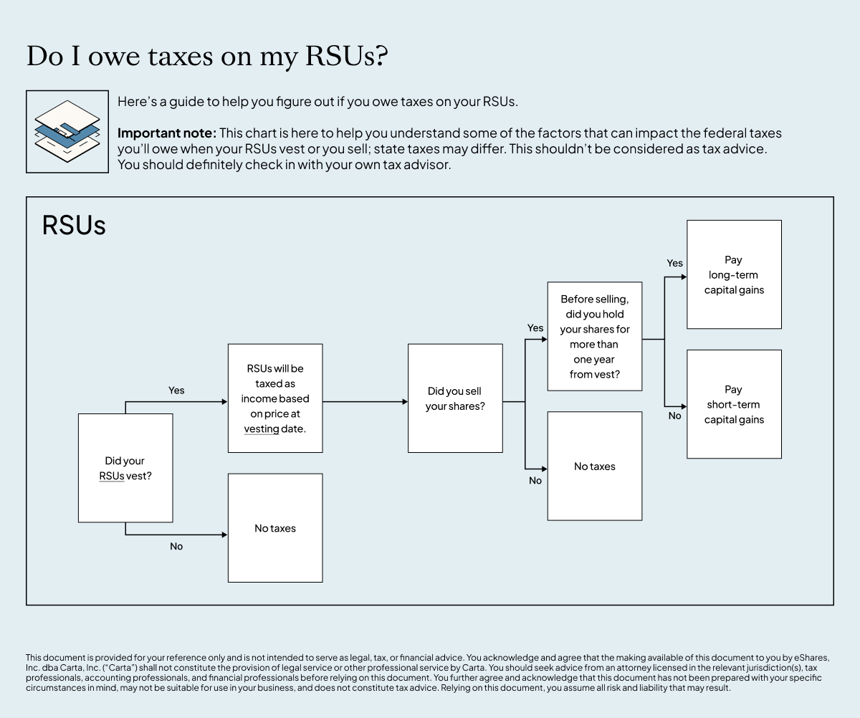
Tax Timing Overview
Generally no tax at grant
Ordinary income tax when RSUs vest and shares are delivered
Based on fair market value of shares delivered on vesting date
Reported on employee’s W-2
Possible capital gain or loss later when shares are sold
After vesting, held shares later and sold
Any appreciation in value or loss from vesting date to sale is capital gain/loss
Short-Term/Long-Term depends on holding period post-vest date

Slide 22
RSU Vesting Implications
When employee leaves employer with vested RSUs then those are property
Implications to non-vested when Employee leaves
Time-vested RSU may become vested even after Employee leaves
The employer adds “Double-Trigger” Vesting condition to avoid Time-vested RSU after Employee leaves
Meaning time-vested RSU will also state “must be present”
Employee who leaves without being present then forfeits the vesting and shares

Slide 23
When Can RSUs be sold?
Dependent on financial situation or confidence in company’s future success consider:
Your company’s trading policy: Not all companies allow you to sell RSUs, or if they do, they may have restrictions around when or how to sell
How you think the stock will perform in the future: If you believe in your company’s future success, it might make sense to hold onto your RSUs for longer so the stock can appreciate more before you sell.
Your cash-flow needs: If you need immediate cash, selling your stock can be a great way to access liquidity.
How much you’ll be taxed: You’ll need to hold your RSUs for more than a year to qualify for lower long-term capital gains tax rates. If you haven’t held your stock for a year, you may want to consider holding onto it for longer.
Whether to diversify the portfolio: Owning stock in a single company can be higher risk. To diversify, may consider investment portfolio, and consider selling some of the RSUs in order to make other investments.

Slide 24
Tax at Grant
At grant, you only hold a right to future shares
Like an option but dependent on certain conditions to be met
Conditions like meet gross revenues or achieve net income or other standards set by board of directors
Rights to future shares only exercisable when event/condition is met
No taxable income in most standard RSU plans
No taxable income upon entering contract
Taxable income only at vesting date
No payroll or income tax withholding at this stage

Slide 25
Tax at Vesting
Fair market value (FMV) of shares at vest is taxable income
Only FMV which is share price x number of vested shares
Public markets and private markets each have share prices
Taxed as supplemental, ordinary wage income (similar to a cash bonus)
Subject to federal, state, and local income tax (if applicable)
Also subject to Social Security and Medicare (FICA) taxes

Slide 26
How Tax Is Withheld
Employer typically withholds tax at vesting
Common methods:
Share withholding (company holds back some shares and pays cash for taxes)
Sell‑to‑cover (broker sells some shares to pay taxes)
May need to hold remaining shares
Sometimes may choose whether to hold or sell right away
Cash withholding from regular paycheck
Withholding is often at a flat “supplemental wage” rate
Generally flat 22% for income up to $1,000,000
Above $1,000,000 the flat rate is 37%
BEWARE: check individual effective tax rate

Slide 27
Under‑Withholding Risk
Flat withholding rate may be below your actual marginal rate
Large vests can push you into higher tax brackets
i.e. Going from 24% to 32%
Result: surprise balance due and possible underpayment penalties
May need estimated tax payments or updated W‑4 elections

Slide 28
Cost Basis Basics
Amount taxed at vest becomes your cost basis per share
Basis = shares vested × FMV at vest (plus certain fees)
Basis is used later to compute capital gains or losses on sale

Slide 29
Tax When You Sell Shares
After vest, stock is treated like any other investment
Sale price vs. cost basis determines gain or loss
If sold immediately at vest price → minimal gain or loss
If held and price changes → capital gain or loss

Slide 30
Capital Gains Rules
Holding period starts the day after vesting
Tax treatment depends on how long post-exercise stock is held
Held ≤ 1 year: short‑term capital gain/loss (taxed as ordinary income rates)
Held > 1 year: long‑term capital gain/loss (preferential capital gains rates)

Slide 31
Double Taxation Trap
W‑2 already includes RSU income at vest
Broker 1099‑B may show a low or zero cost basis – true basis may be reported on a supplemental schedule or may need to be obtained from vesting documents
If basis not adjusted, the same income can be incorrectly taxed again as capital gain
Important to correct cost basis on tax return to avoid double tax – report as an adjustment to basis.

Slide 32
State and Local Tax Issues
RSU income often sourced where work was performed during vesting period
Moving between states can create multi‑state filings
Different states may have different sourcing and withholding rules

Slide 33
83(b) Election: Not for RSUs
Section 83(b) election generally applies to restricted stock, not RSUs
RSUs usually do not qualify because you do not hold actual shares until vest
Most employees cannot accelerate RSU income using 83(b)

Slide 34
83(i) Deferral (Niche Case)
Section 83(i) can allow certain private‑company employees to defer income tax
Applies only to eligible stock options/RSUs under strict plan rules
Deferral can last up to 5 years, but payroll taxes still due at settlement
Complex requirements; relatively rare and requires professional advice
Private companies need to wait for liquidity event (like acquisition or IPO or tender offer) OR
Private company may approve third-party buyer to purchase shares

Slide 35
Key Risks with RSUs
Concentration risk in employer stock after vesting
Stock price can drop after vest: income already taxed, but loss may not fully offset
Tax complexity: W‑2, 1099‑B, basis adjustments, multi‑state rules

Slide 36
RSU Tax Implications
Action | Tax implication
Your company gives you an RSU grant. | No immediate tax implication.
Your RSUs vest and are settled. | You’ll owe ordinary income tax on the FMV of your shares at the time of settlement.
Your RSUs are settled and you sell the shares immediately at the FMV. | You’ll owe ordinary income tax on the FMV of the shares you acquired and no capital gains tax on the sale of the shares (because the sale price was the same as your tax basis).
You sell your shares within one year of receiving them. | If you sell at a price higher than the FMV of your shares at vesting, you’ll also likely owe short-term capital gains tax on the difference.
You sell your shares after holding them for more than a year. | If you sell at a price higher than the FMV of your shares at vesting, you’ll also likely owe long-term capital gains tax on the difference.

Slide 37
Common Employee Mistakes
Assuming employer withholding fully covers final tax bill
Not tracking vesting dates, share counts, and vest prices
Ignoring cost basis and being double‑taxed on sale
Holding large positions in employer stock without a plan

Slide 38
Practical Strategies
Consider selling all or part of each vest immediately (“cash‑out and diversify”)
Use proceeds to build a diversified portfolio instead of concentrated employer risk
Coordinate RSU income with:
Retirement plan contributions (401(k), IRA)
Charitable giving
Estimated tax payments

Slide 39
Record‑Keeping Checklist
Track for each vesting lot:
Vest date and number of shares
FMV at vest (your cost basis)
Sale date, number of shares sold, and sale price
Keep copies of: W‑2s, 1099‑Bs, brokerage statements, and plan documents

Slide 40
Questions to Ask Your Advisor
How will my RSU income affect my tax bracket and credits?
Should I sell at vest or hold for potential long‑term gains?
Do I need estimated tax payments to avoid penalties?
What is a reasonable target allocation to my employer’s stock?

Slide 41
Important Disclaimers
RSU rules and tax treatment can vary by plan and jurisdiction
This material is general education, not tax, legal, or investment advice
Always consult a qualified tax professional or financial advisor about your specific situation

Slide 42
RSUs vs Stock Options Key Difference
Here are some major differences
Less dilution
RSU is worth one full share with no strike price – companies grant fewer RSUs to deliver target dollar value compared to larger number of options
No Cost to exercise
RSUs have no strike price
Less risk if stock price goes down
RSU still worth something even if stock price goes down’
Options may be “underwater” if FMV falls below strike price

Slide 43
RSUs vs Stock Options Key Difference Continued
Equity | Value proposition | Pros | Cons
RSUs | The value of RSUs is much easier to measure. They’re worth whatever the company stock is worth at the time of issuance. They don’t need to be purchased so there’s less risk. | RSUs will require less equity burn (from the company) to provide similar value to the candidate. | Employees have no control over the timing of the taxes or the tax rate (compensatory). Employees might even lose any RSUs they have “accrued” if they leave before both triggers are met. Results in less alignment between workers and company. Offering RSU liquidity is currently really difficult.
Options | Provides more upside for those employed at high growth companies. Employees can optimize for taxes in a way they cannot with RSUs. | Allows employees to have control over the timing of their tax obligation and allows for participation in liquidity programs such as tender offers. | Results in more equity burn in order to provide similar value to RSUs.As companies mature, exercise costs become a barrier and the gap between preferred and strike price will fall, reducing inherent value.

Slide 44
Thank you!
Anthony Pugh, JD, MBA CPA
317-216-1040
www.mariettacpa.com

