Slide 1
A Behind-the-Scenes
Look at the IRS

Slide 2
Sheila Andrews sheila.l.Andrews@irs.gov
Cell: 317-260-7269

Slide 3
IRS
The Organization

Slide 4

Scott Bessent, Secretary of Treasury and Acting Commissioner, IRS

Slide 5

Frank J. Bisignano
Chief Executive Officer
of the Internal Revenue Service

Slide 6

Jarod Koopman
(Acting)Chief Tax Compliance Officer

Slide 7
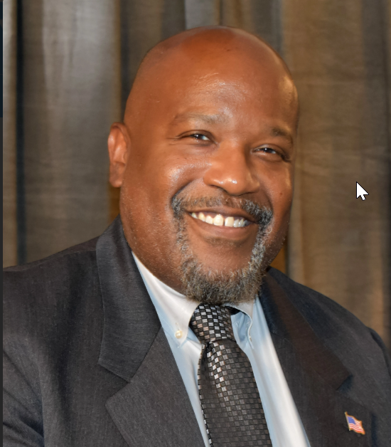
Kenneth Corbin
Chief, Taxpayer Services

Slide 8
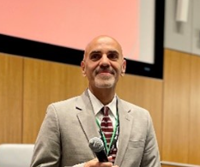
Kaschit Pandya
Chief Information Officer

Slide 9
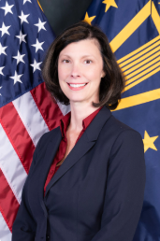
Dottie Romo
Chief Operating Officer

Slide 10
Resumption of Work
Following the 2025 Lapse in Appropriations
(Status as of 11-19-2025)

Slide 11
Taxpayer Service
and
Processing

Slide 12
Taxpayer Service to Individuals
Taxpayer Assistance Center Appointments
Smart Scheduler

Slide 13
Processing Returns – Individual
Electronic – within 21 days
Paper – Original Returns – Received in October 2025
Paper – Amended Returns – Received August 2025

Slide 14
Processing Returns – Business 1120 Series
Original Returns – Received in September 2025
Amended Returns – Received March 2025
Processing Returns – Form 941
Original Returns – Received in September 2025
Amended Returns – Received March 2025
Processing Returns – Form 1041
Original Returns– Received in September 2025
Amended Returns – Received March 2025

Slide 15
Processing – Other Forms
Letters and Notices
Individual General Correspondence - July 2025
Business General Correspondence – March 2025
Other Correspondence* – June 2025
* Includes Injured Spouse, Exempt Organization
and Employee Plans

Slide 16
Audits
and
Audit Questions

Slide 17
Collections
and
Collection Questions

Slide 18
Appeals
and
Appeals Questions

Slide 19
Tax Exempt
and
Government Entities
Tax-exempt Applications
Determination letter and Voluntary compliance Statement Application for Retirement Plans
Credit Payment to Qualified Bonds Issuers

Slide 20
Resources
and
Reminders

Slide 21
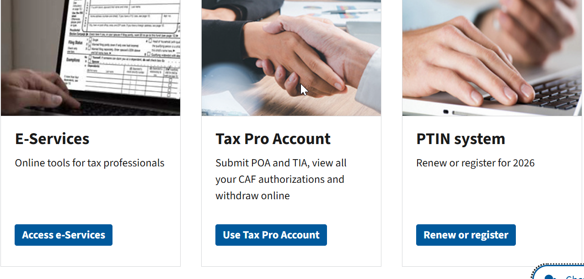

Slide 22
Renew Your PTIN
By December 31st

Slide 23
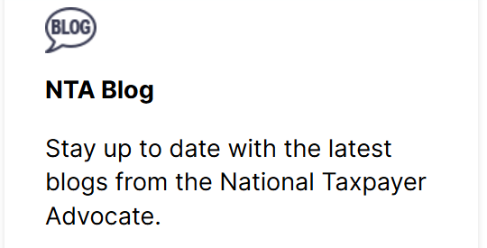

www.taxpayeradvoctate.irs.gov
Scroll to the bottom of page

Slide 24
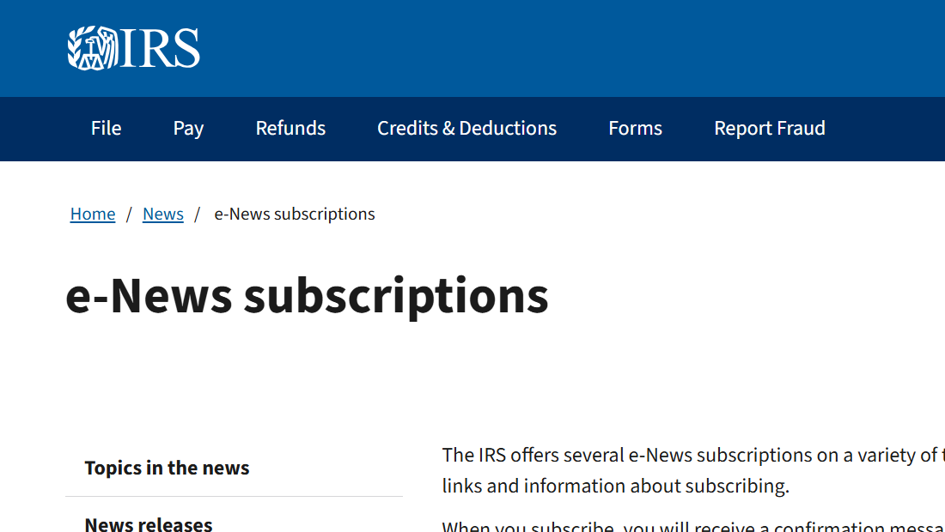

Slide 25
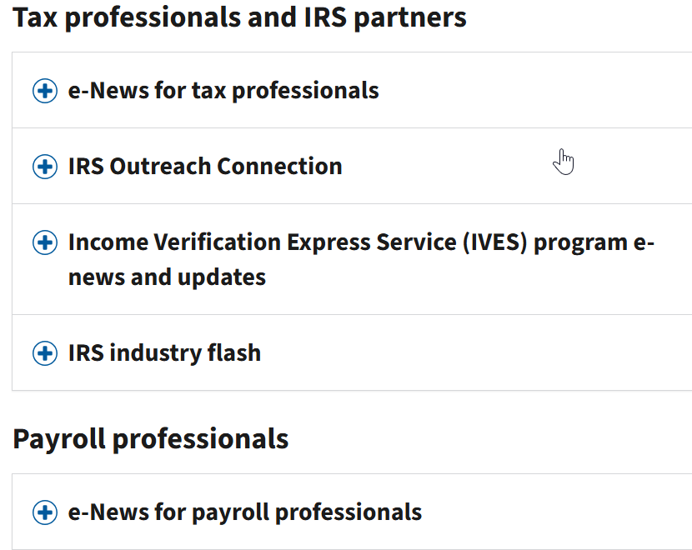

Slide 26
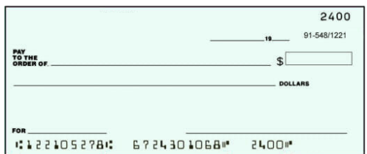
The Future of Paper Checks

Slide 27


